Slide 1
Sequence Classification via Graph
Alenka Tang & Omar Madjitov

Slide 2
Introduction
Classification is not a new topic in bioinformatics. In the analysis of gene expression data, genes obtained from microarray data are clustered and genes in the same cluster are considered to trigger the same function. Sequence classification is an important task in bioinformatics to produce stable, quick, and accurate results.
This project proposed a method using graphical models for sequence classification where the graph model will provide the features for training classifiers.

Slide 3
Hypothesis
This research project is build on the assumption that similar subsequence have similar functions and by constructing graphs from the sequence data will give us subsequence (node) and structure information which can be used for sequence classification.

Slide 4
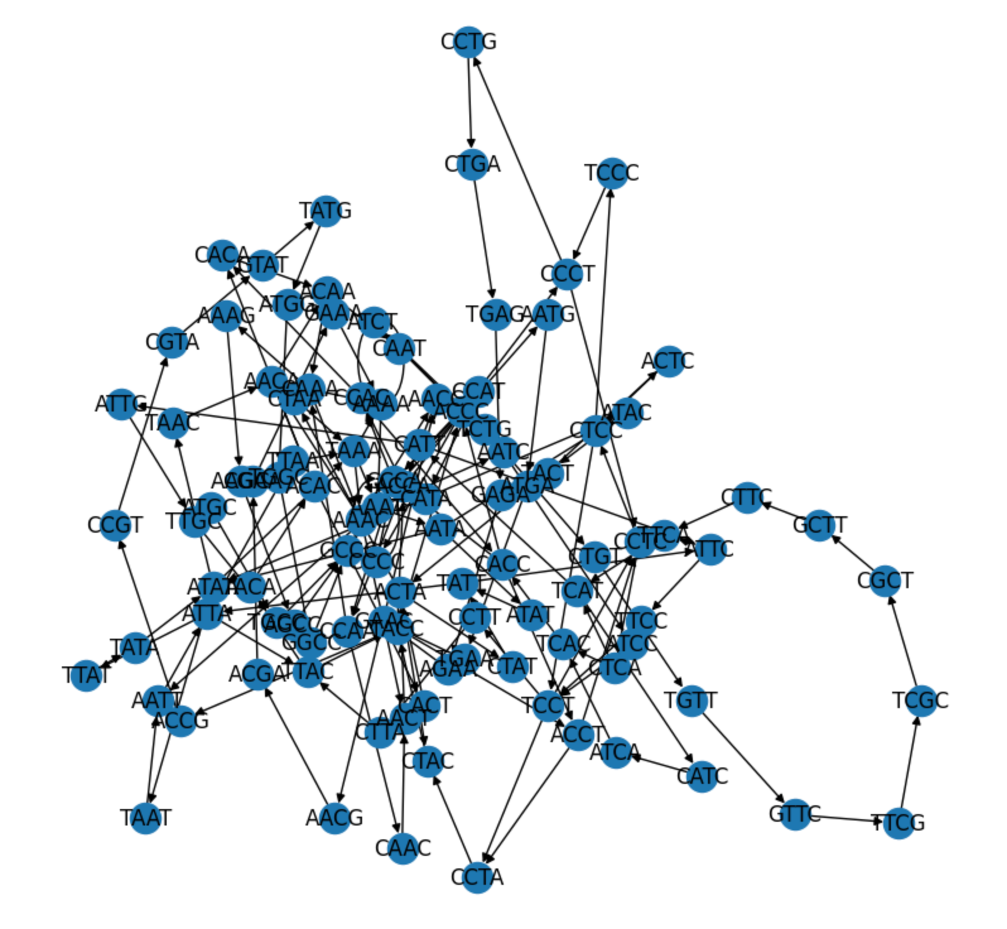
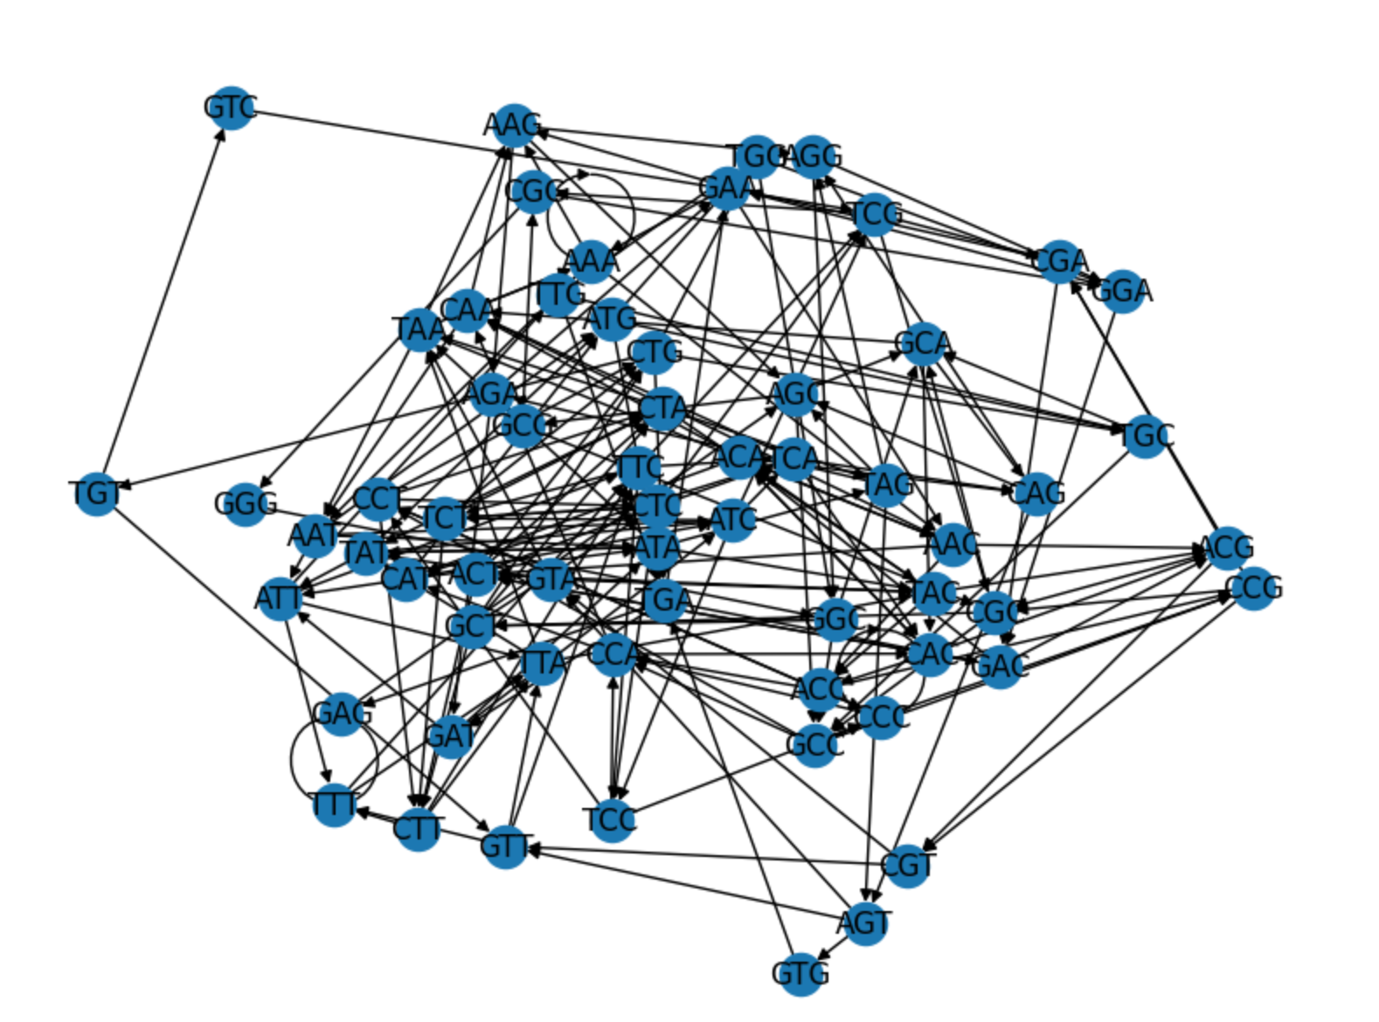
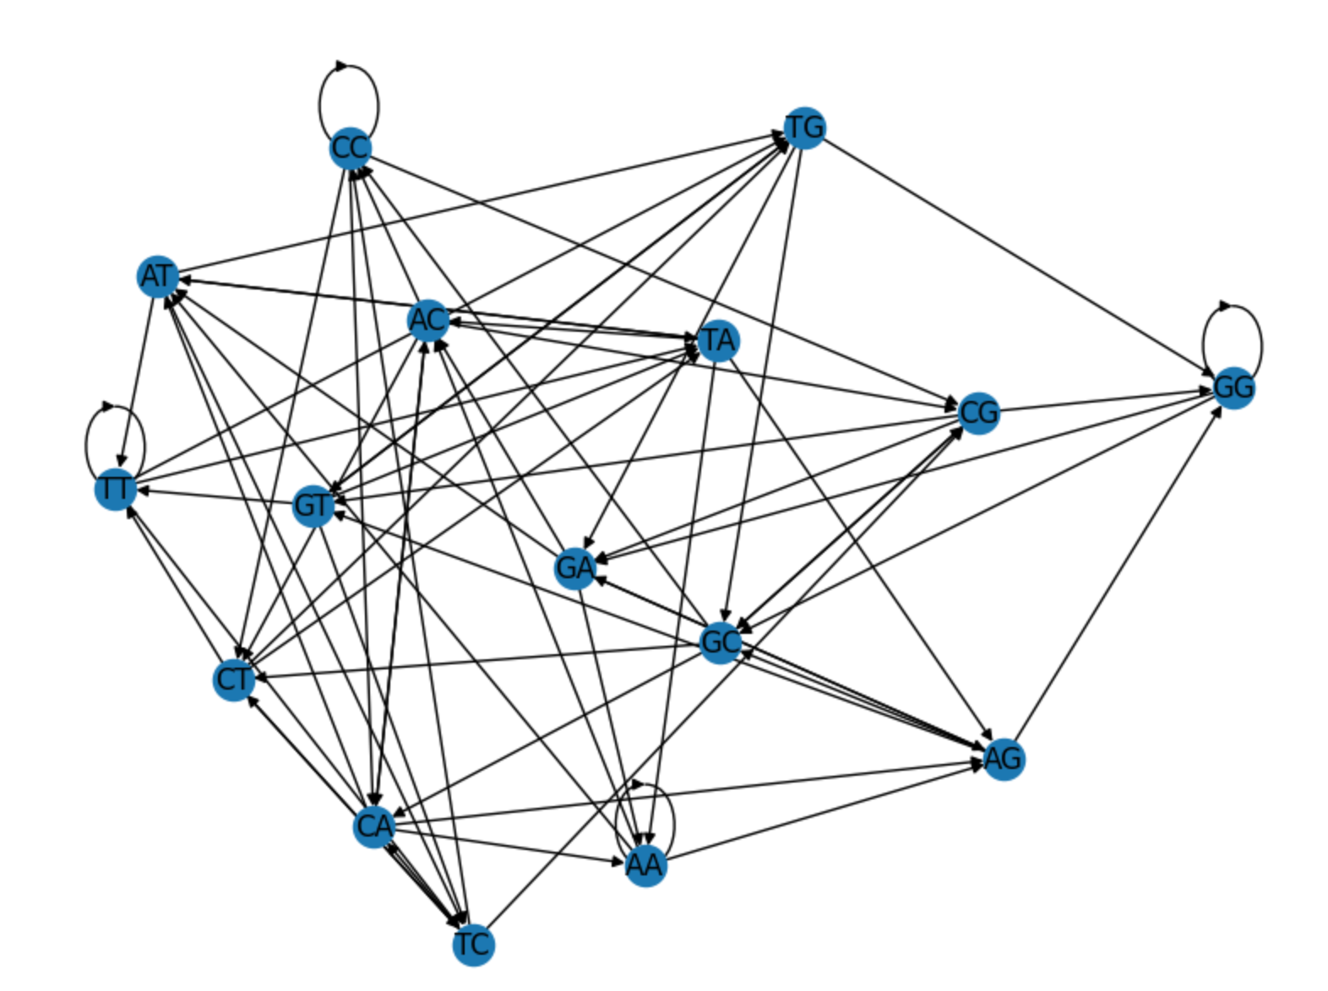
De-Bruijn Graph Construction

Slide 5
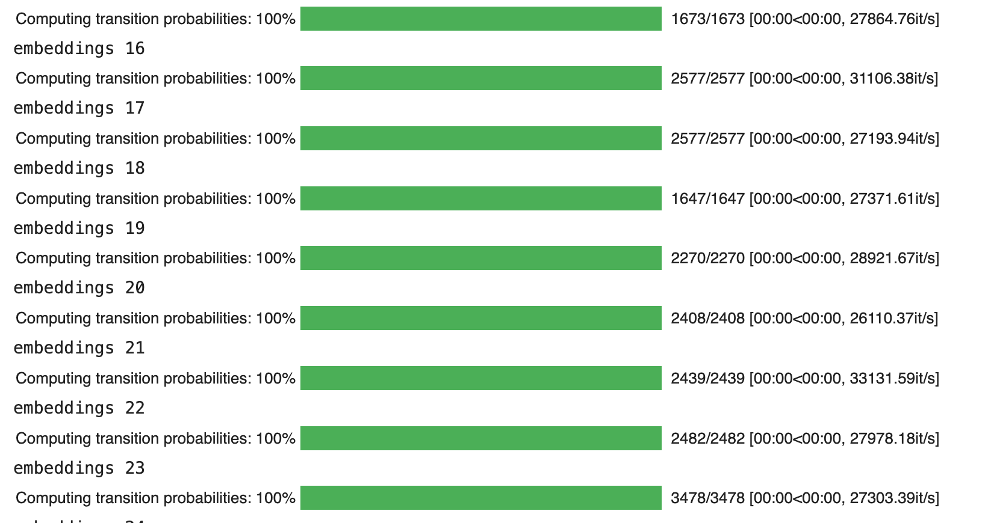
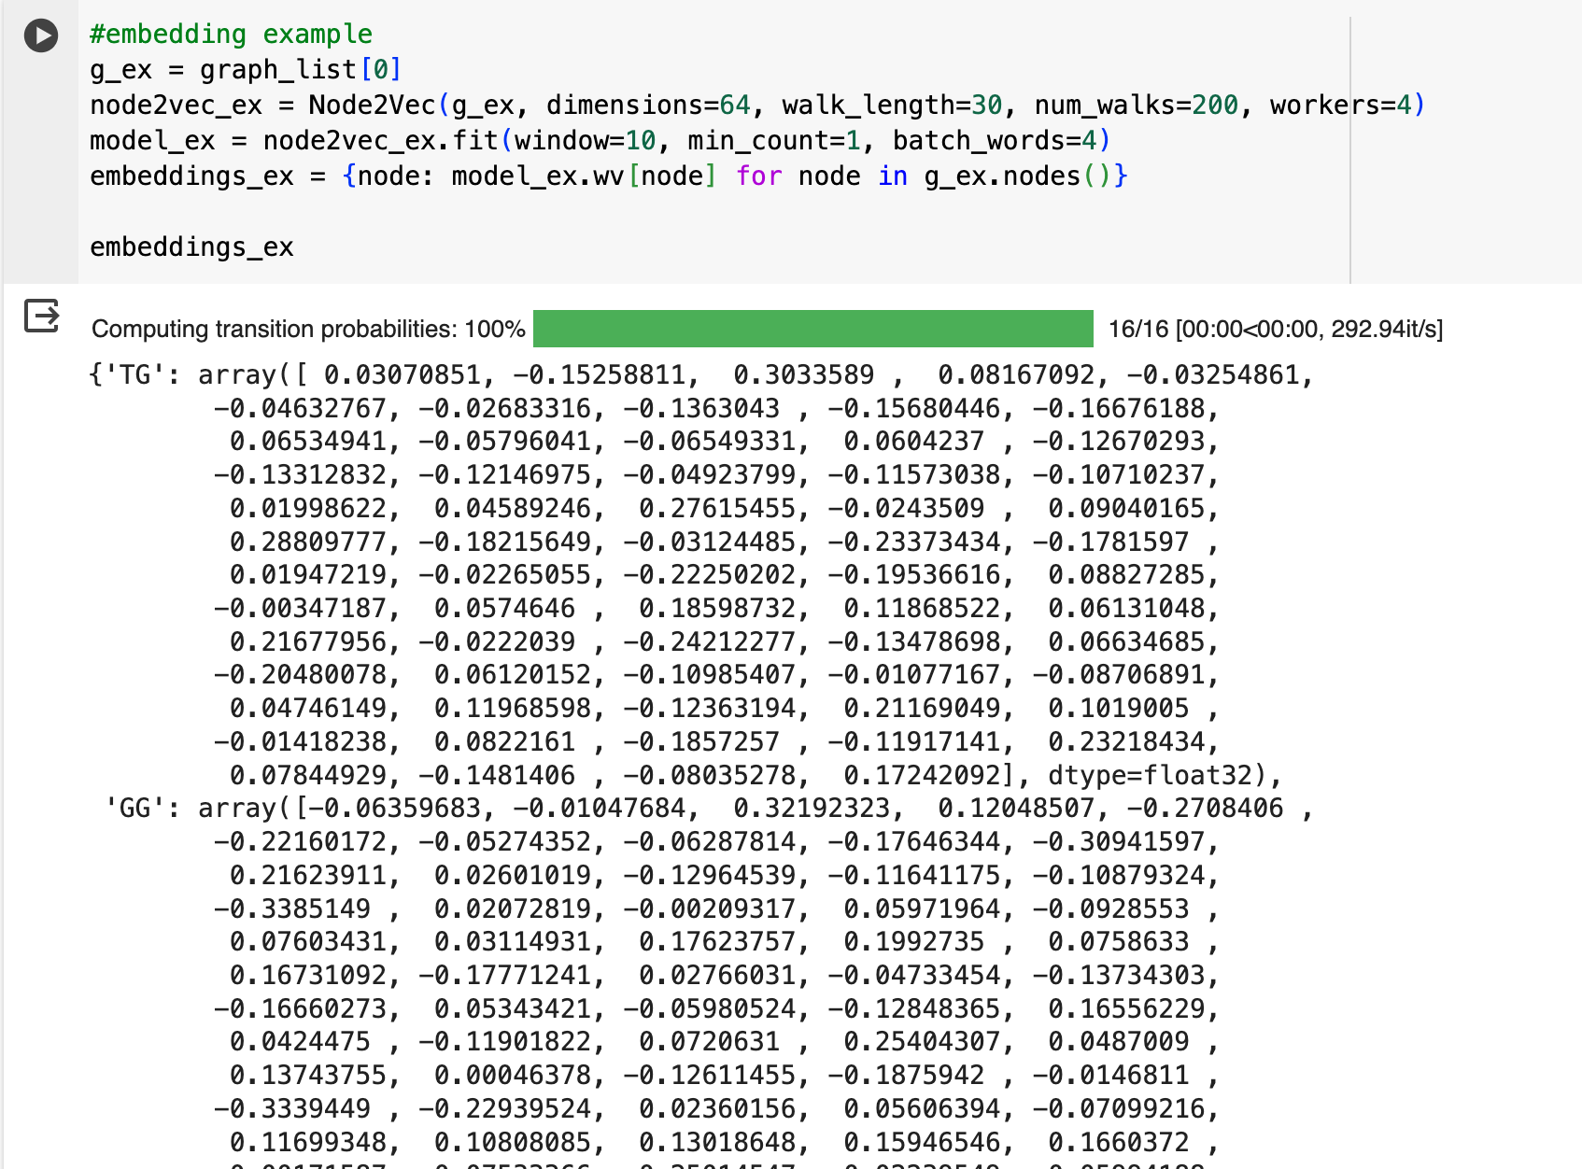
Node embedding and graph feature representation
We first used Node2Vec with 64 dimensions to generate feature vector for each node of the graph then we sum up the same feature for all nodes to get the feature vector for the entire graph. Therefore allowing each sequence to have its unique feature vector from the graph.

Slide 6
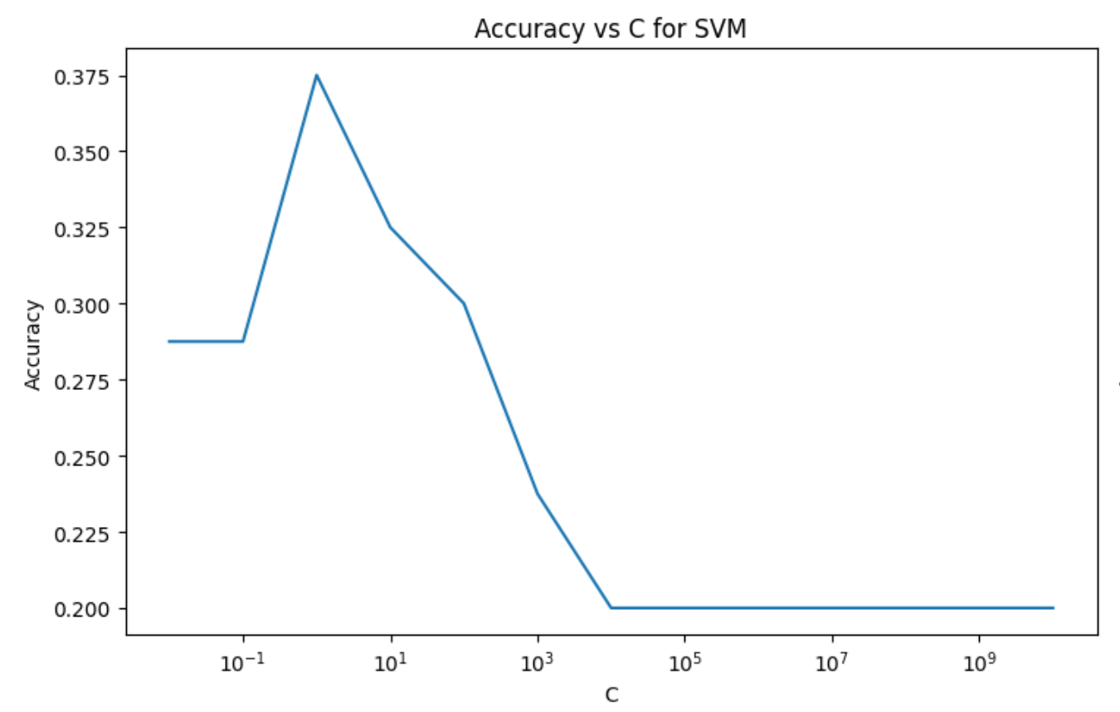
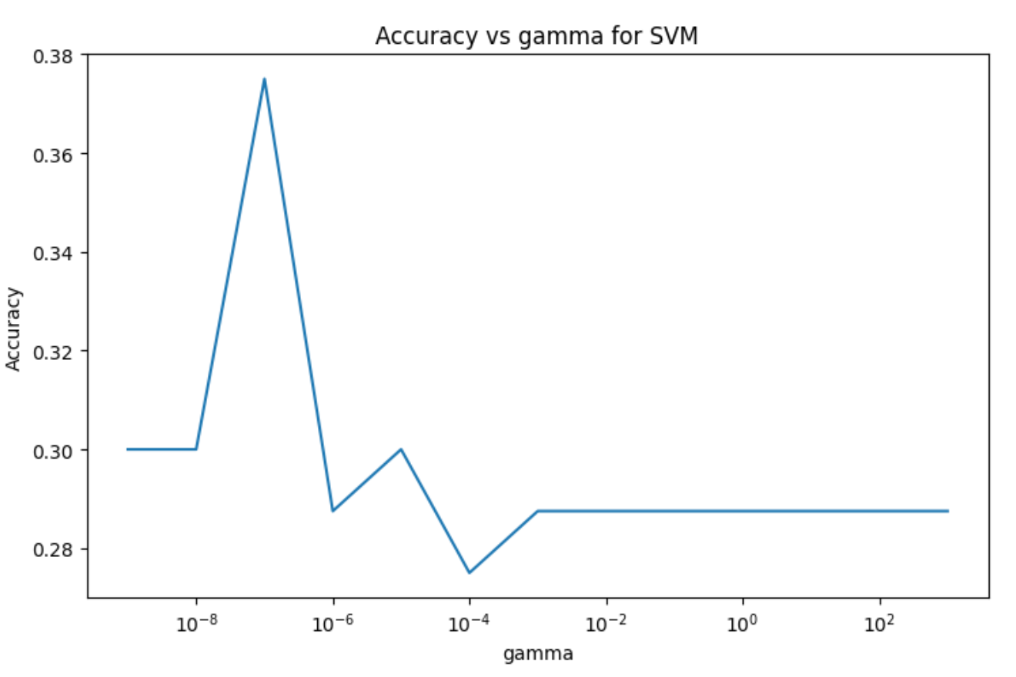
Classifier
The accuracy with the default parameter value with kmer = 3, 5, 10 is 27%, 50% and 36.5%
We also tested different C and gamma value for the rbf kernel as well as using the linear kernel.

Slide 7
Challenge and Future Work
The random work for Node Embedding is very computationally heavy and the current embedding fell short on capturing the different subsequence appearing in each sequence data.
We could combine the graph/node embedding with informations on the subsequences appeared in each sequence as features for the classifiers.

Slide 8
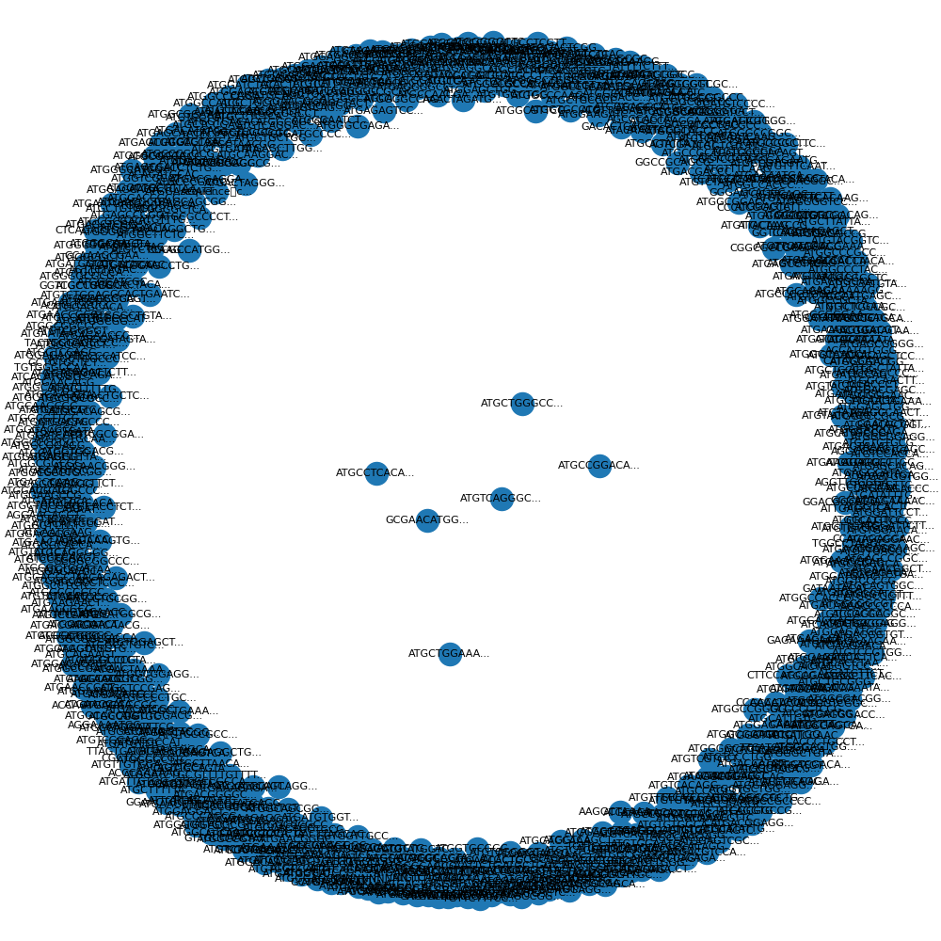
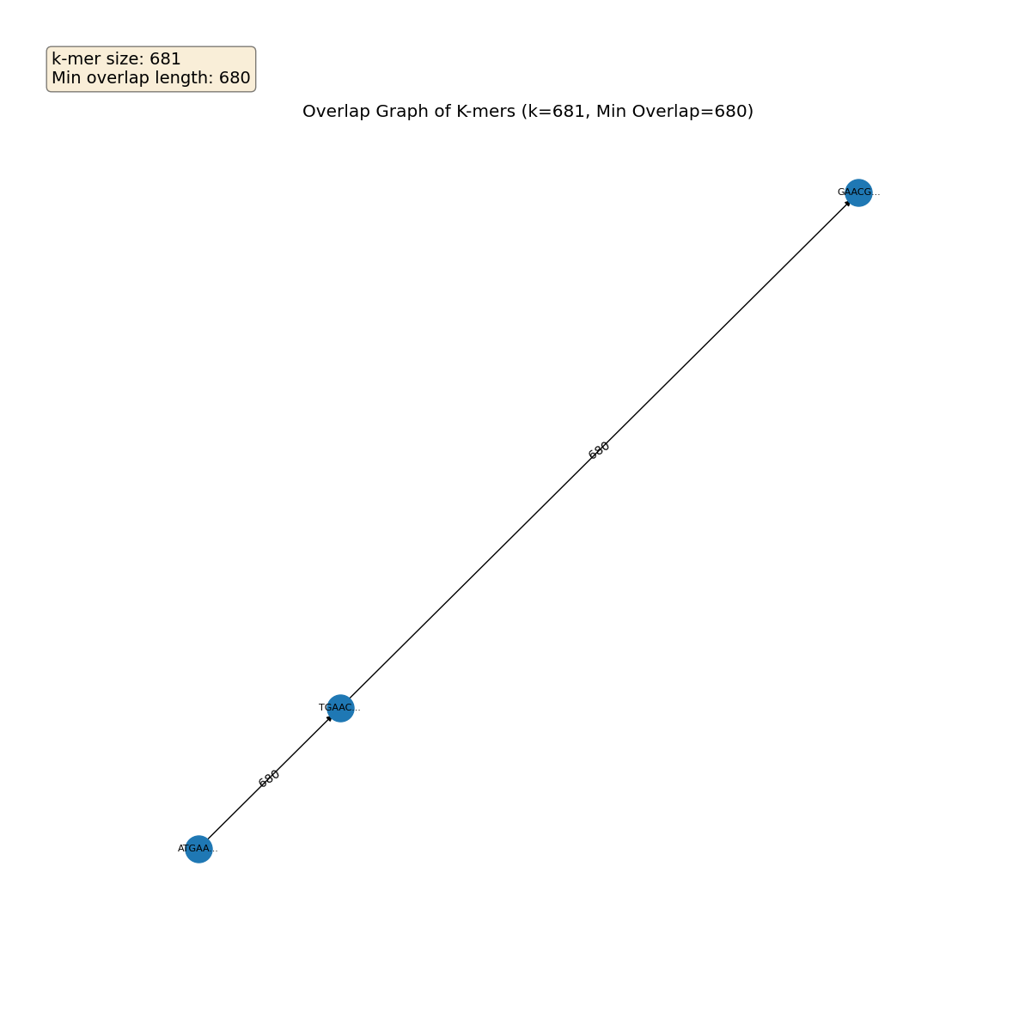
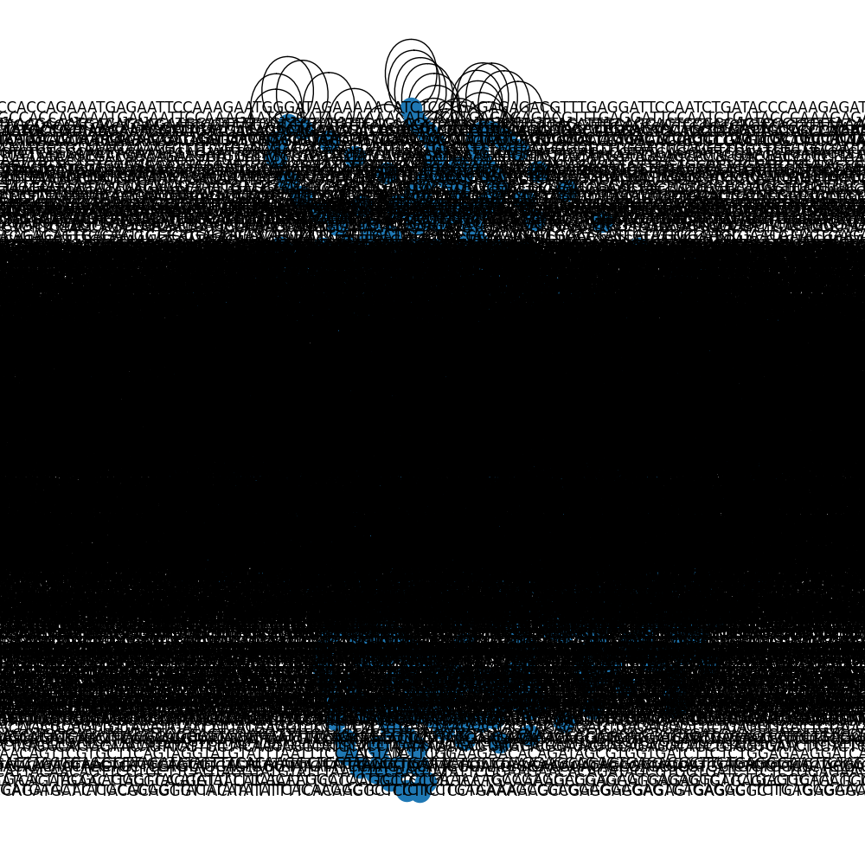
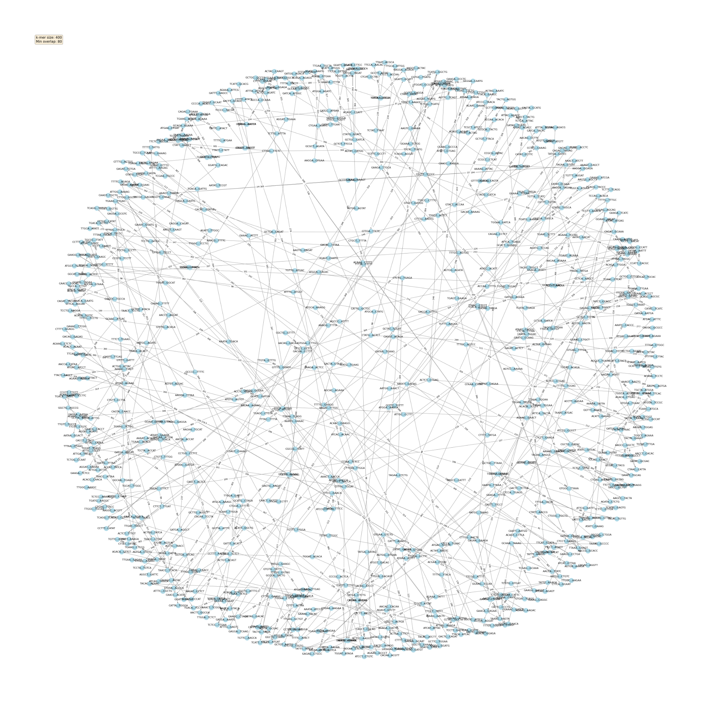
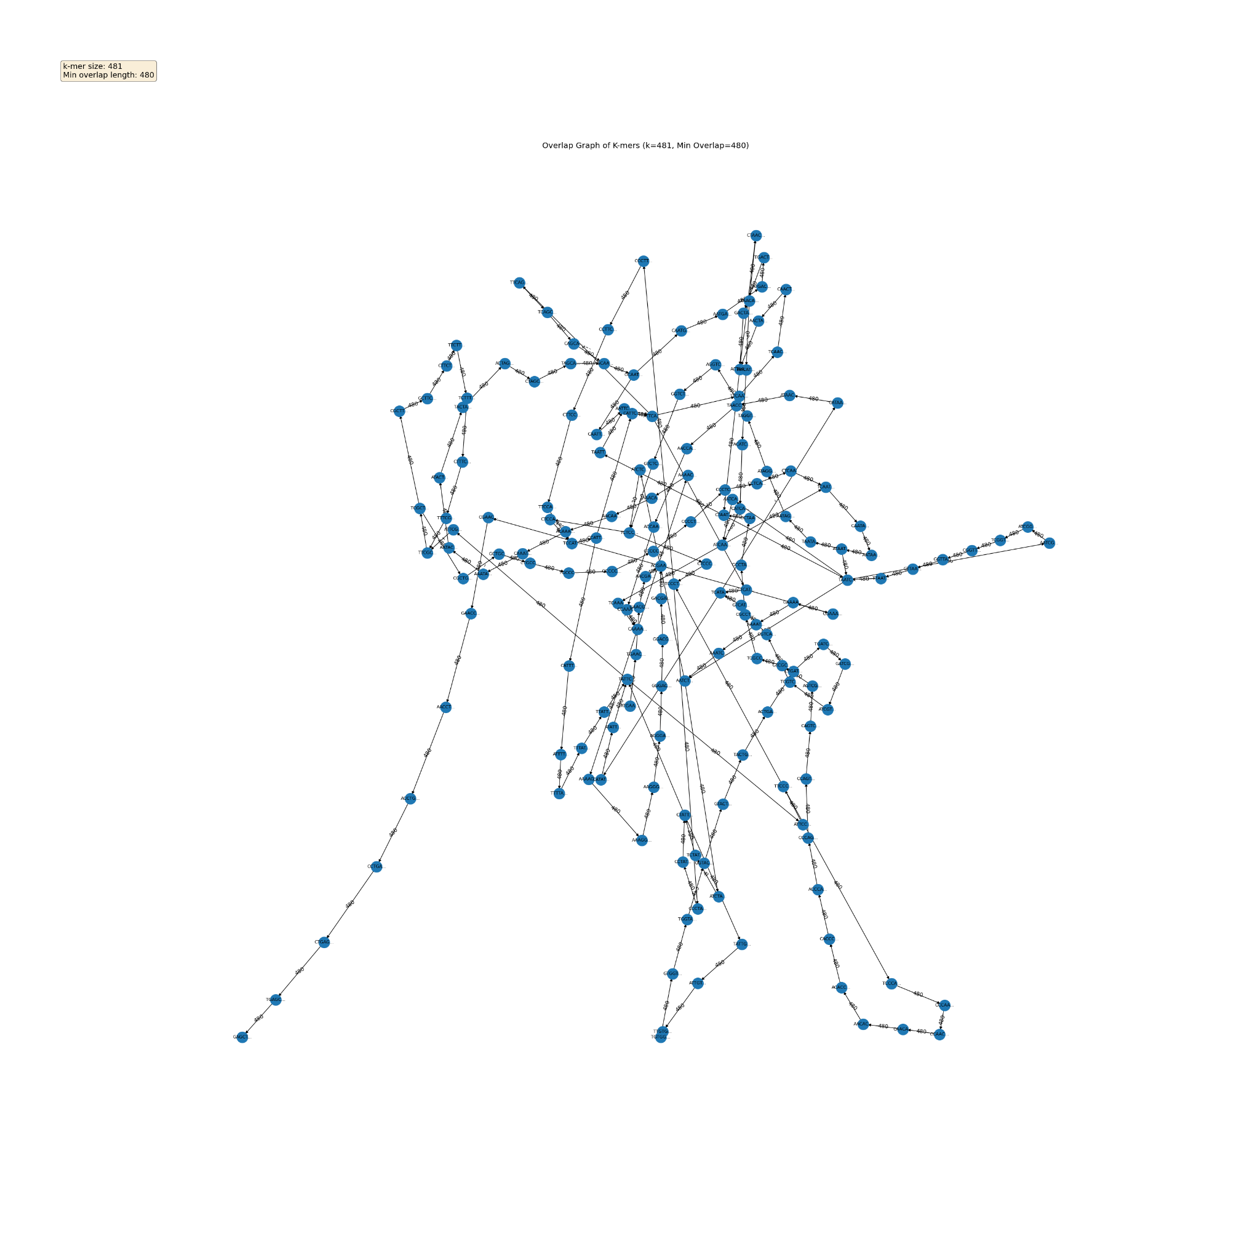
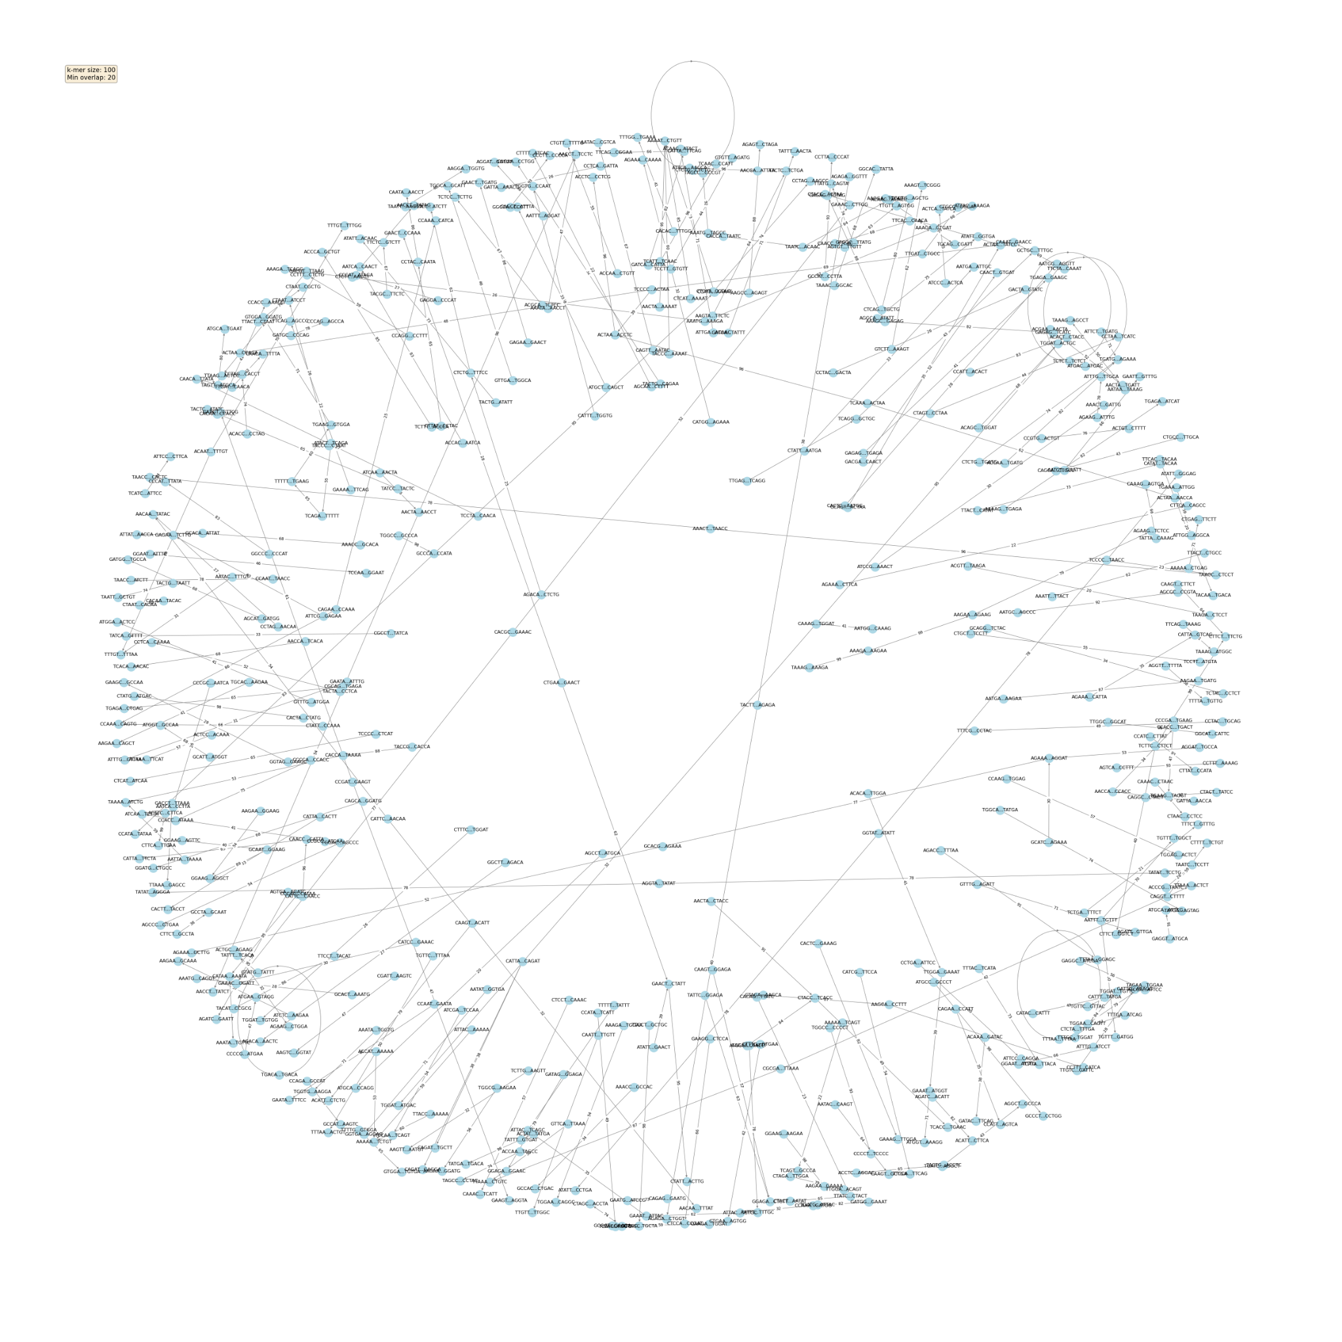
OVERLAP GRAPH CONSTRUCTION
journey…
…yuck

Slide 9
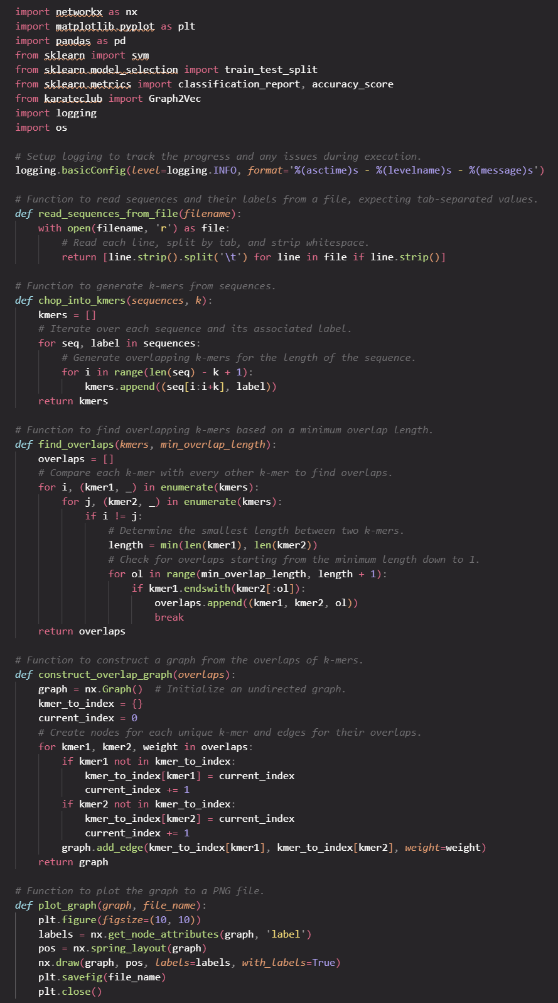
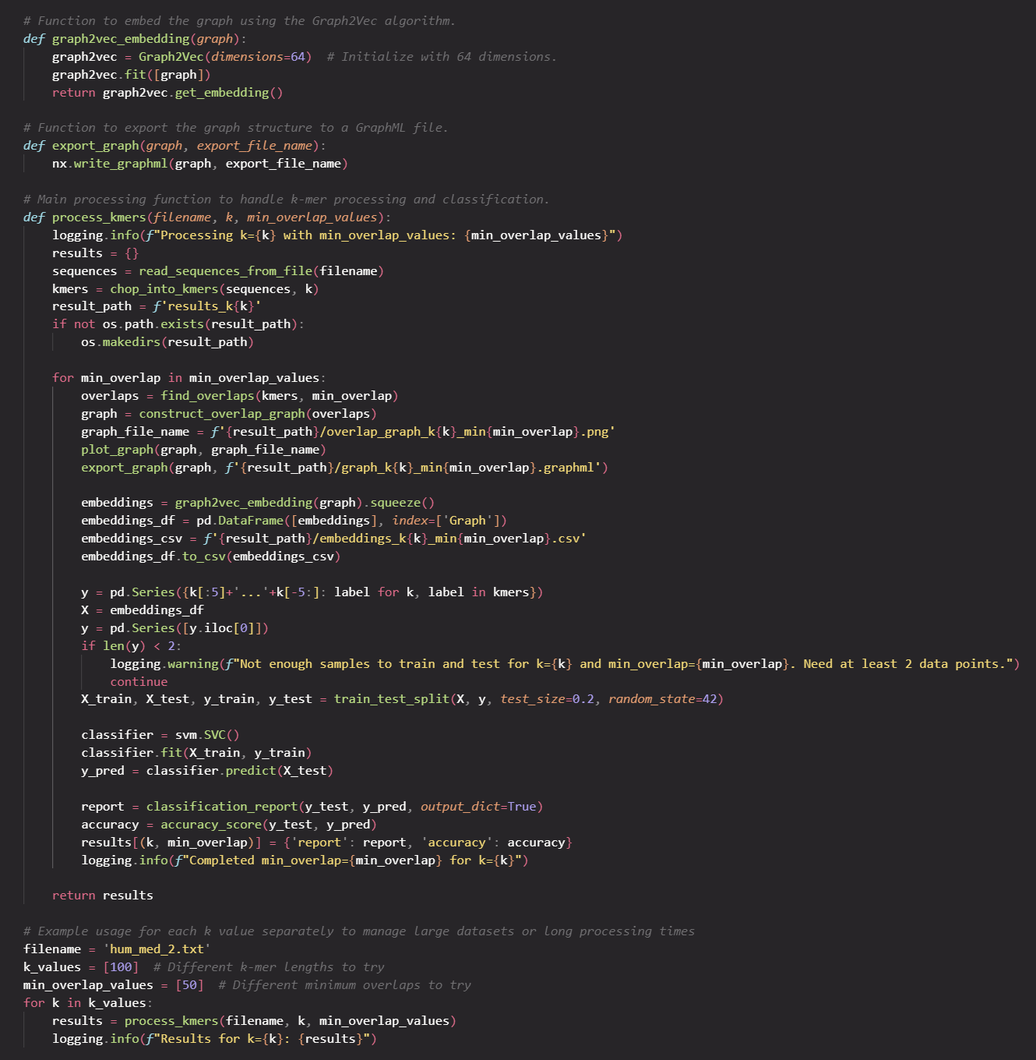
HOW DO YOU EVEN CONSTRUCT AN OVERLAP GRAPH?
←
LIKE
THIS

Slide 10
HOW DO YOU EVEN GET AN OVERLAP GRAPH?
Read Sequences and Create k-mers:
read_sequences_from_file: Extracts sequences and their associated classes from a tab-delimited file.
chop_into_kmers: Chops these sequences into k-mers of specified length k, retaining the associated class label for each k-mer.
Detect Overlaps Among k-mers:
find_overlaps: Checks each pair of k-mers for overlaps where the suffix of one k-mer matches the prefix of another. This overlap must meet a specified minimum length to be considered significant.
Construct the Overlap Graph:
construct_overlap_graph: Creates a graph using NetworkX where each node represents a unique k-mer, and edges represent detected overlaps. The edge weights are determined by the length of the overlap.
Graph Visualization:
plot_graph: Visualizes the constructed graph and saves the visualization to a file.
Feature Extraction via Graph Embedding:
graph2vec_embedding: Converts the graph structure into a fixed-size feature vector using the Graph2Vec algorithm, facilitating the use of graph data in machine learning models.
Export Graph:
export_graph: Saves the graph in a GraphML format for further analysis or use outside the Python environment.
Classification:
The k-mer sequences are prepared for classification by associating each k-mer with its original sequence label. The embeddings from the graph are used as features in a Support Vector Machine (SVM) classifier. The dataset is split into training and testing sets, the SVM model is trained, and its performance is evaluated using classification report and accuracy metrics.
Process Integration and Logging:
process_kmers: Integrates all previous steps into a single function that processes k-mers for different values of k and minimum overlap lengths. Results for each configuration are logged and returned. Incorporates logging throughout to track progress and debug issues.

Slide 11
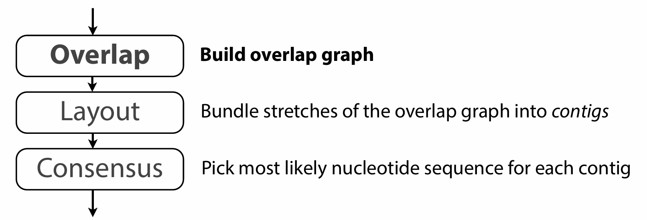
WRONG TURN: GENOME ASSEMBLY
Overlap - Layout - Consensus:

Slide 12
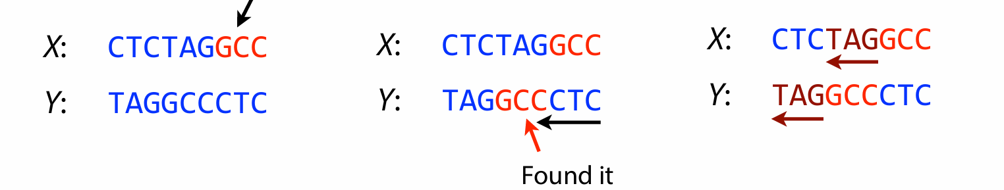
WRONG TURNS:
Overlaps:

Slide 13
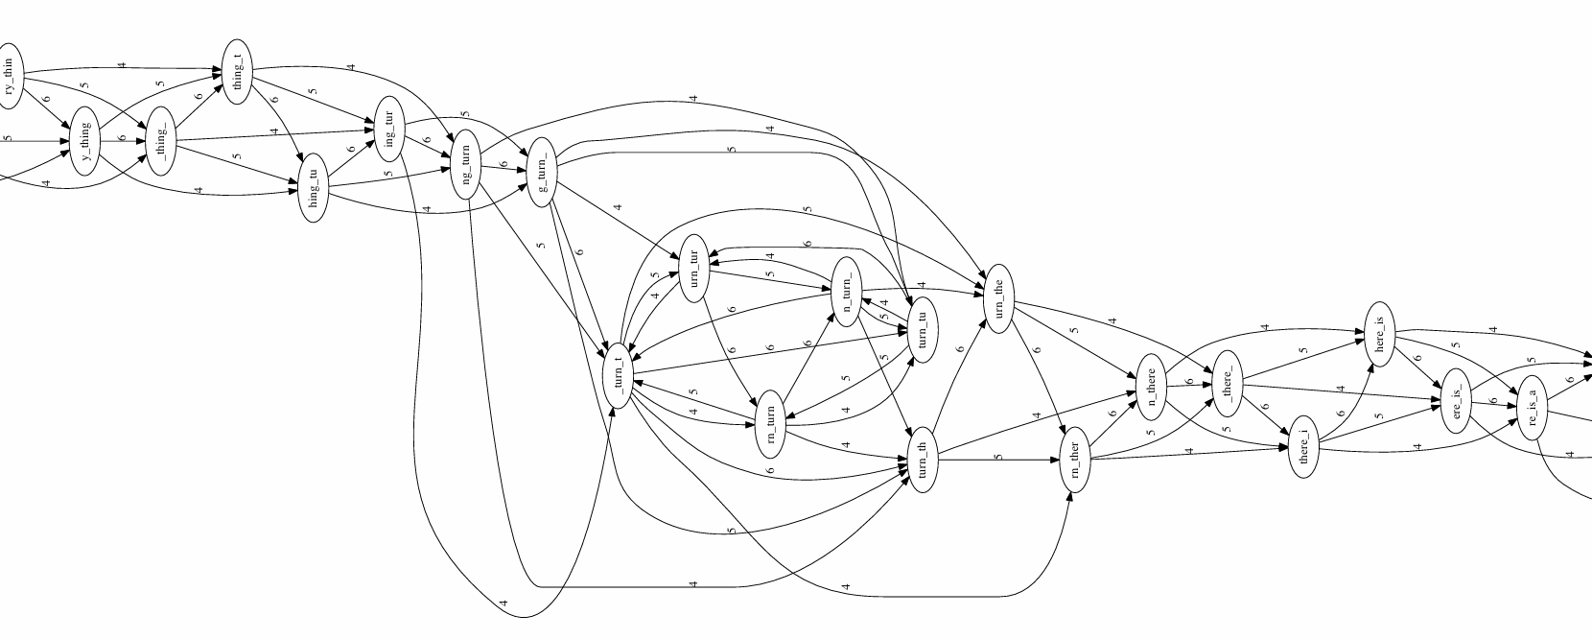
WRONG TURNS:
LAYOUT:

Slide 14
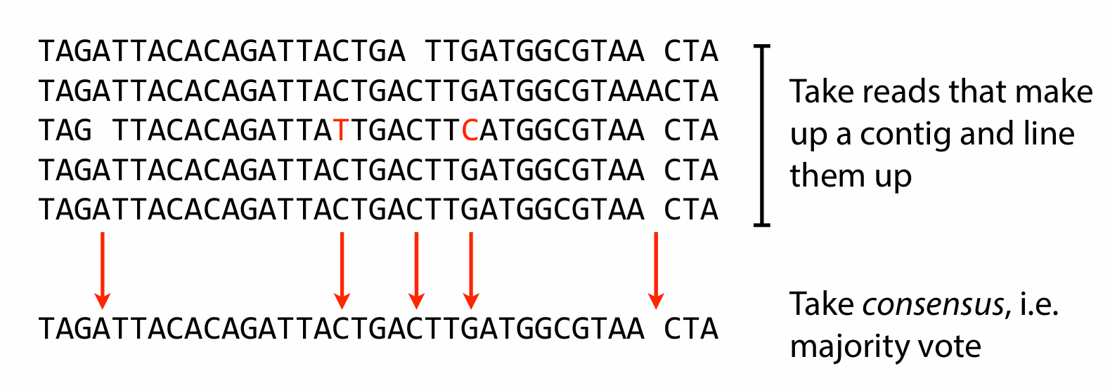
WRONG TURNS:
CONSENSUS:

Slide 15
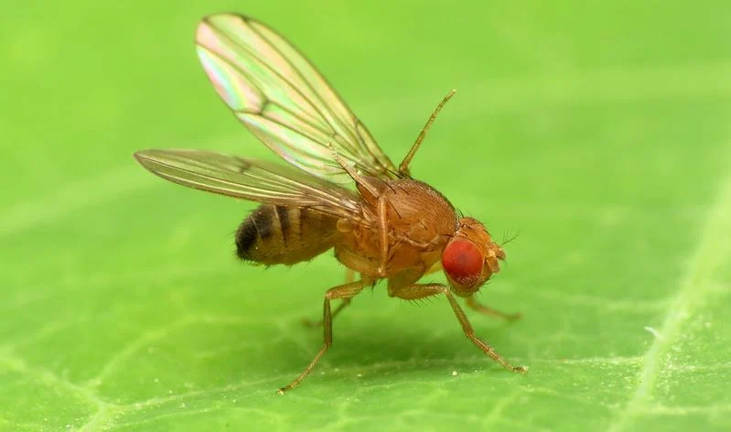
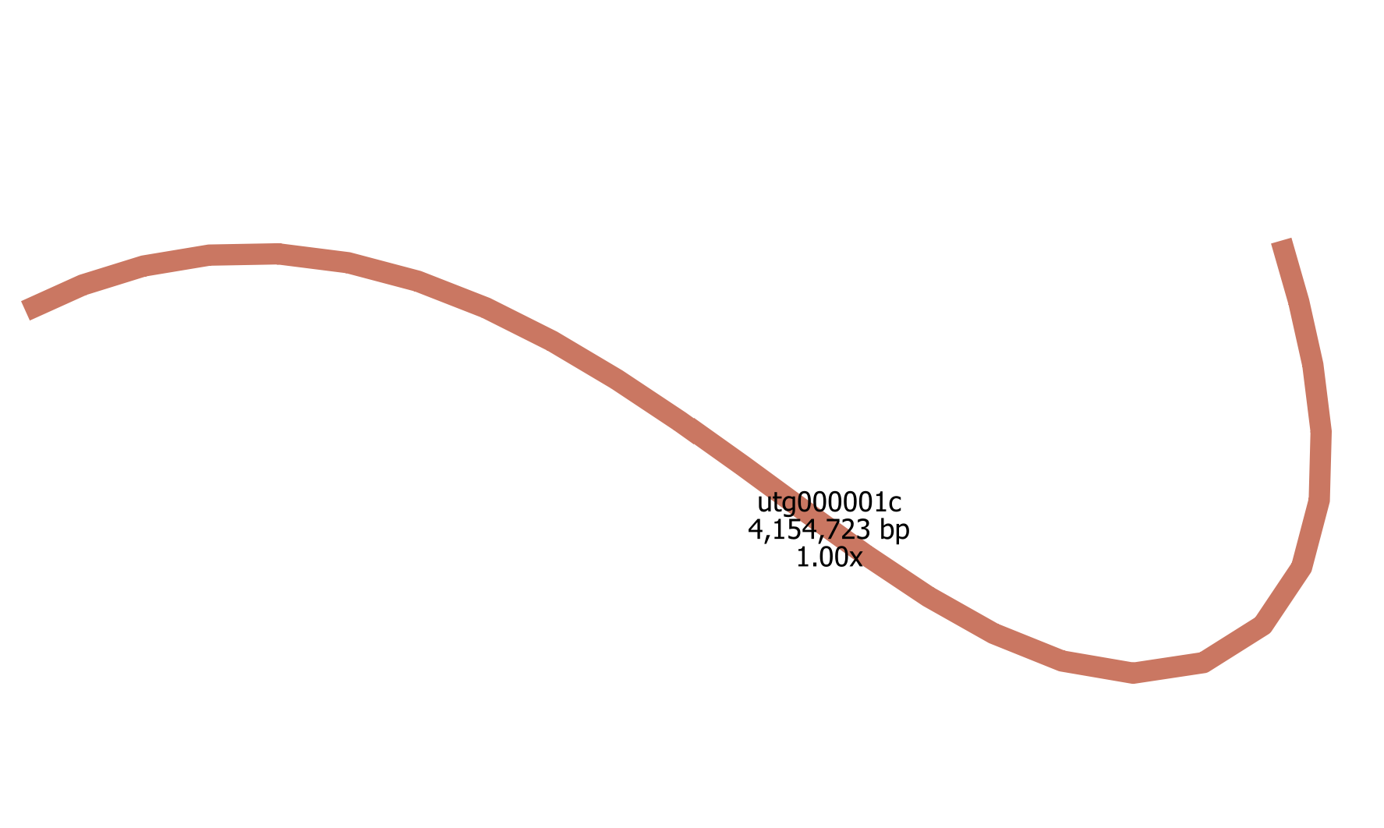
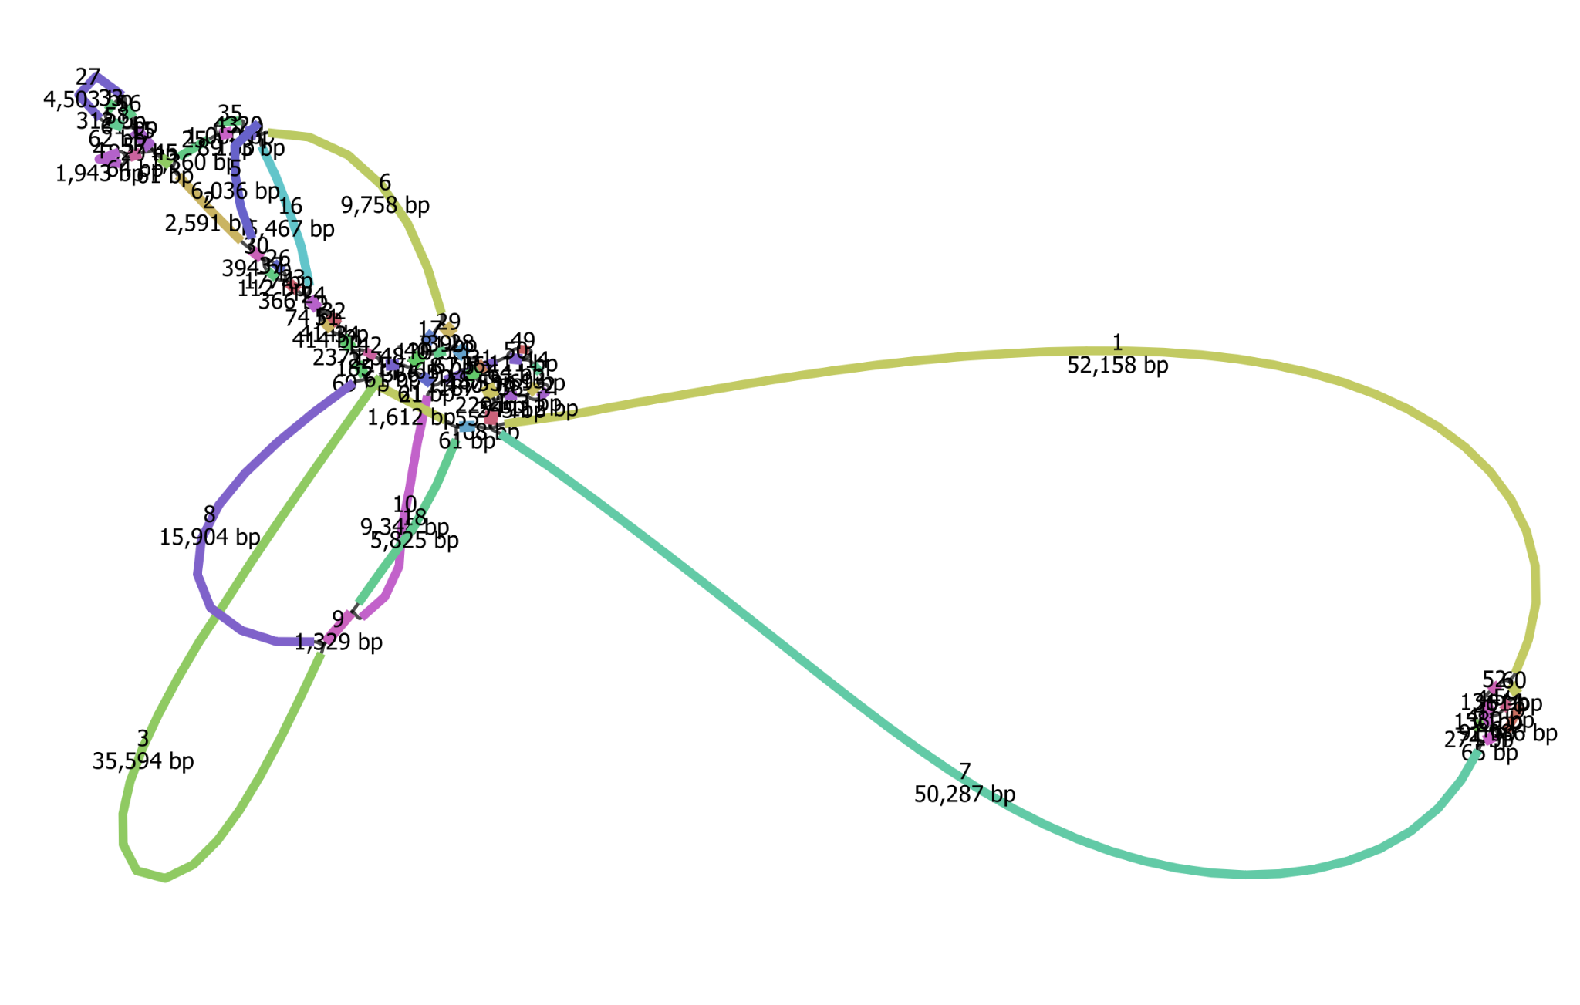
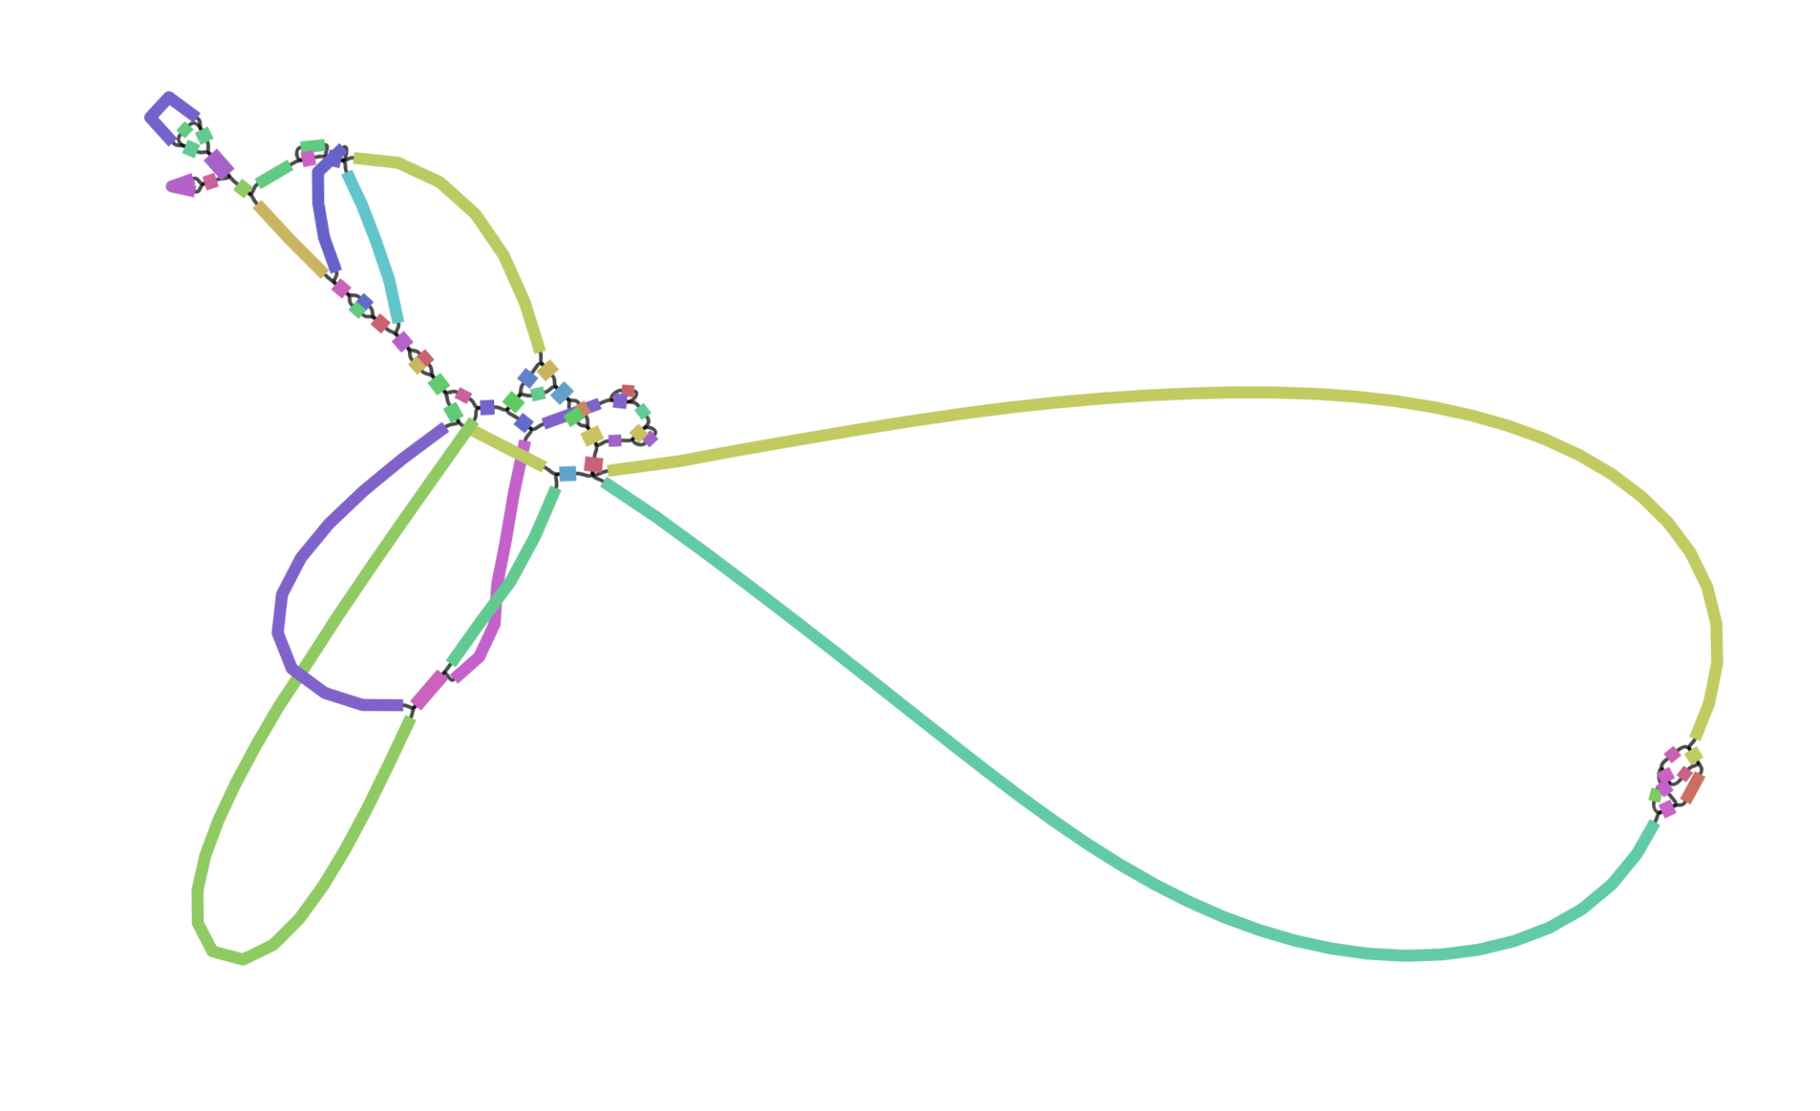
How I assembled a genome on accident w/ Miniasm + Bandage
FRUIT FLY
+
MINIASM

Slide 16
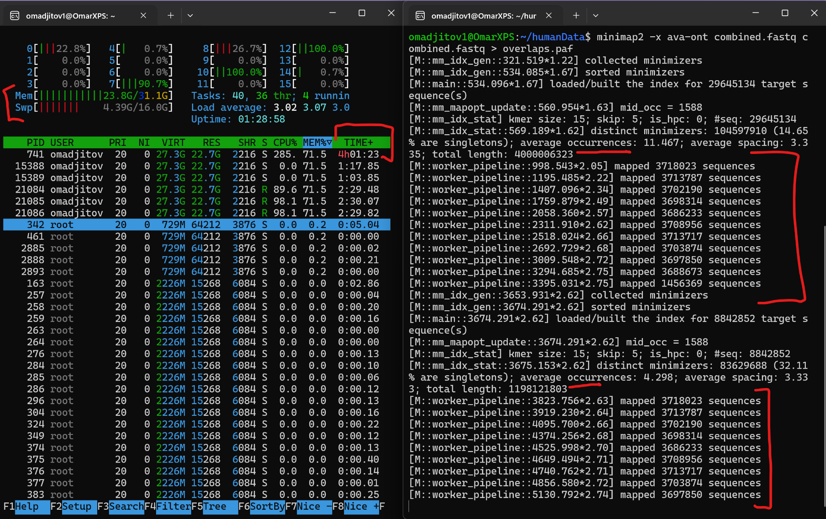
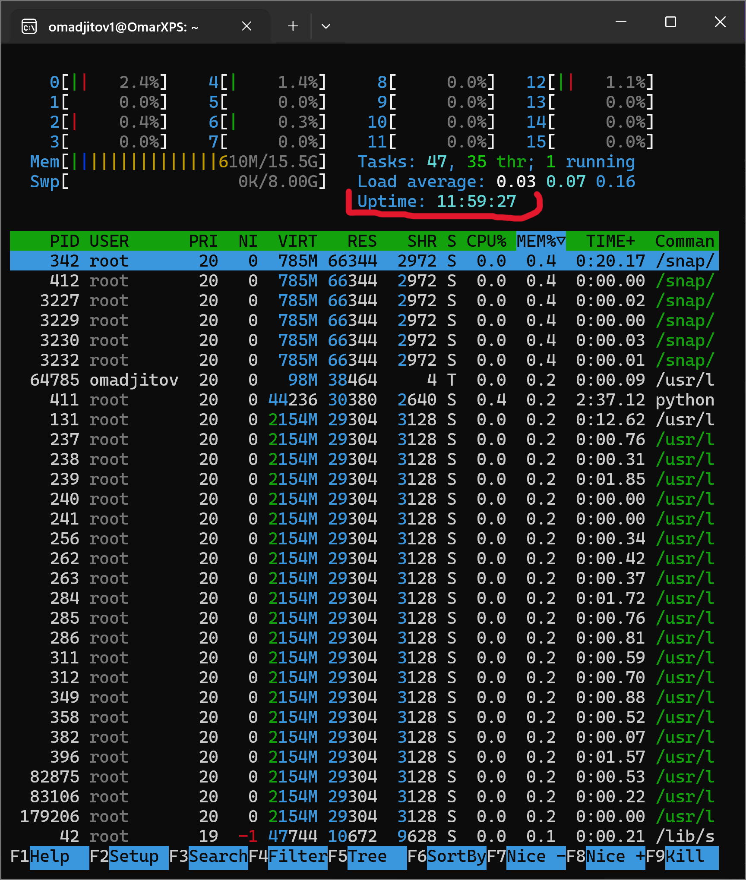
HOW LONG DID IT TAKE ?
→ LONG.
HOW MUCH POWER DID WE NEED?
→ MUCH.

Slide 17
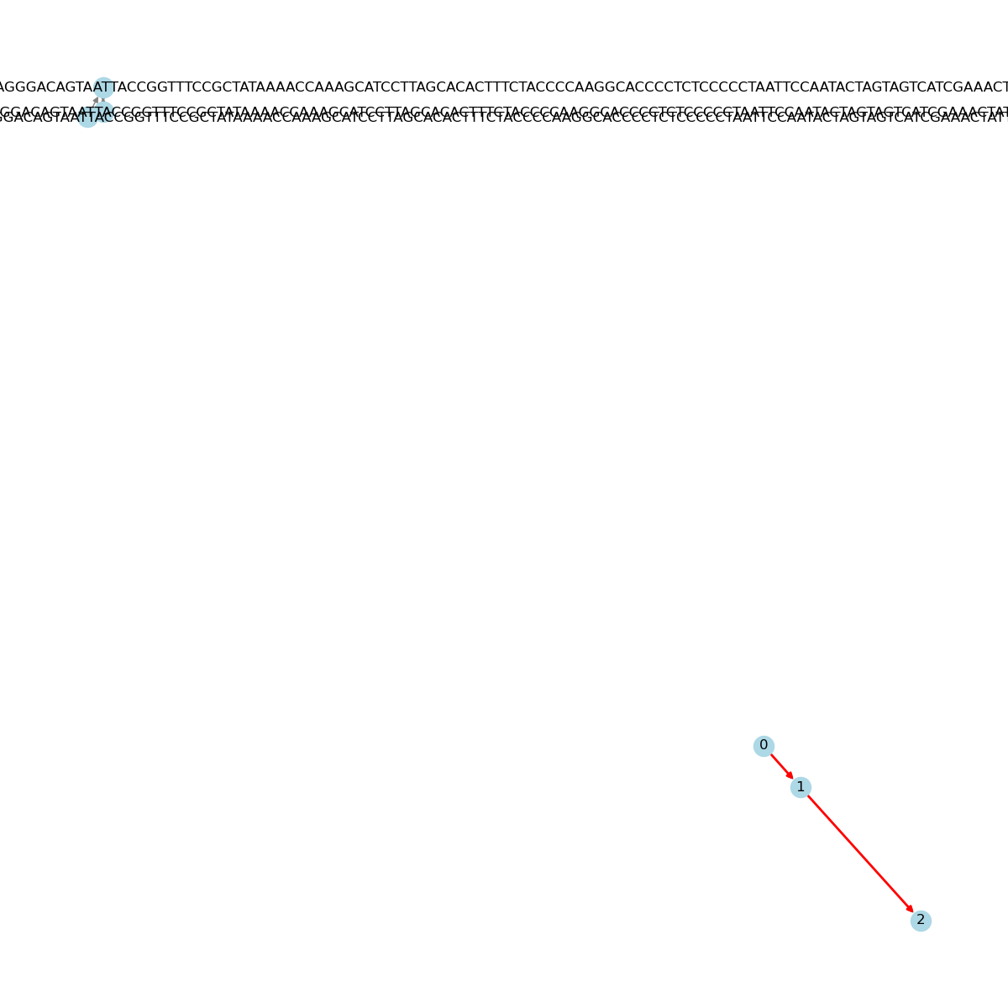
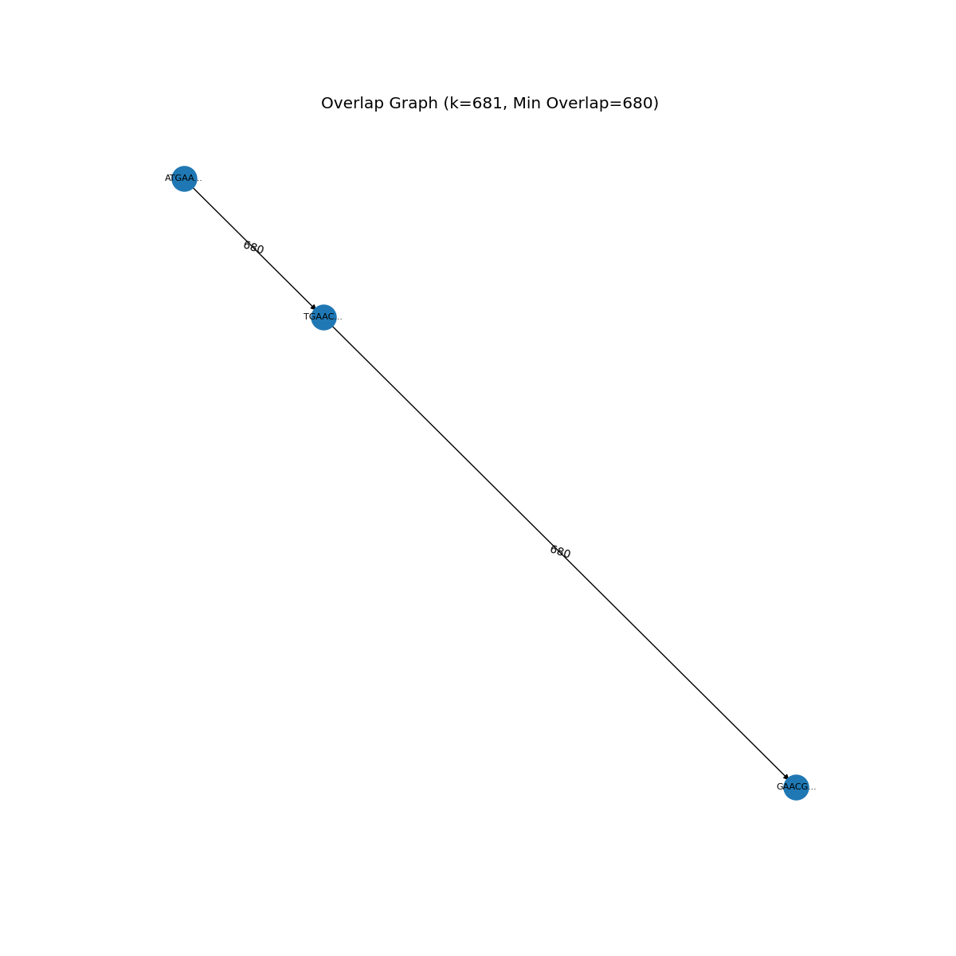
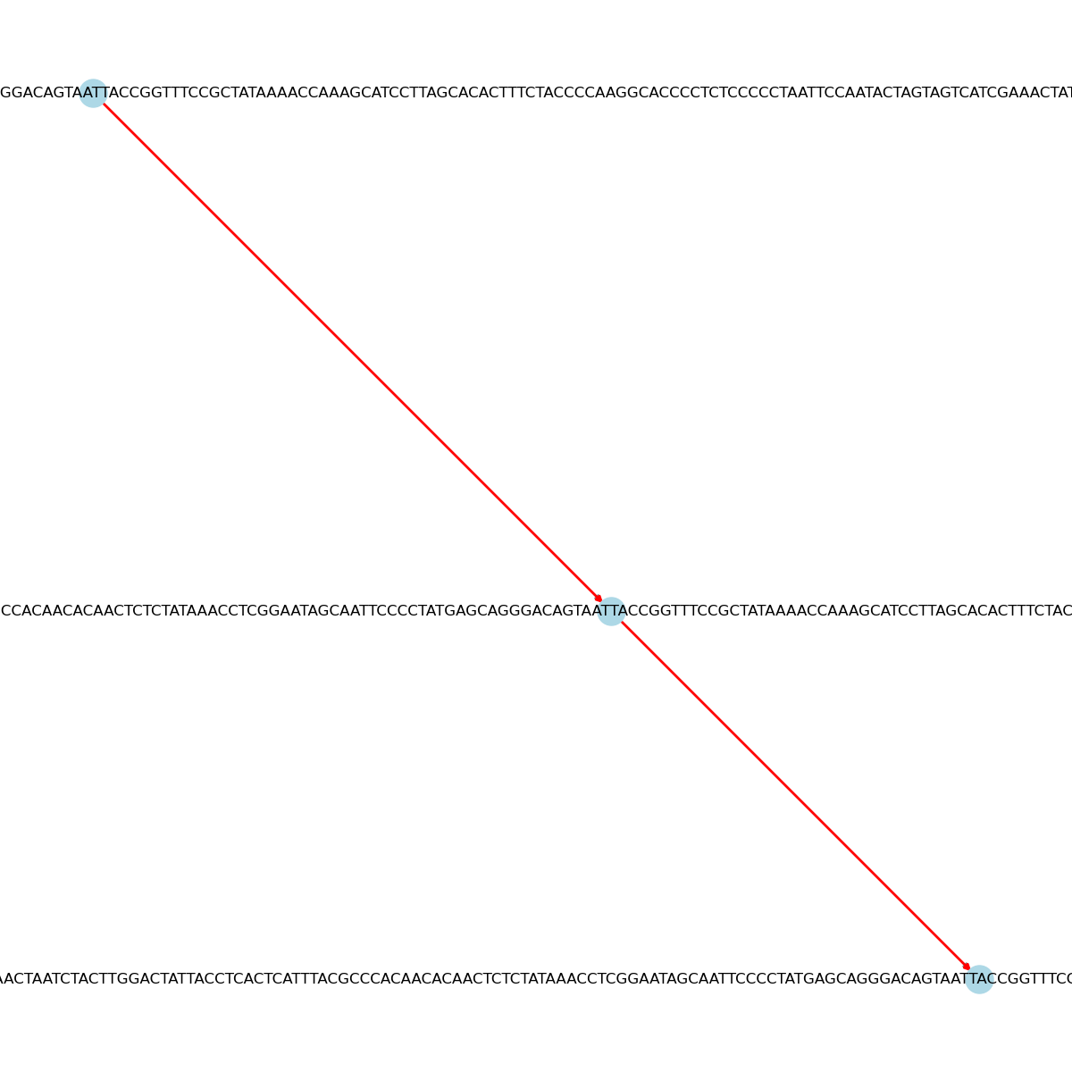
BACK ON TRACK:

Slide 18
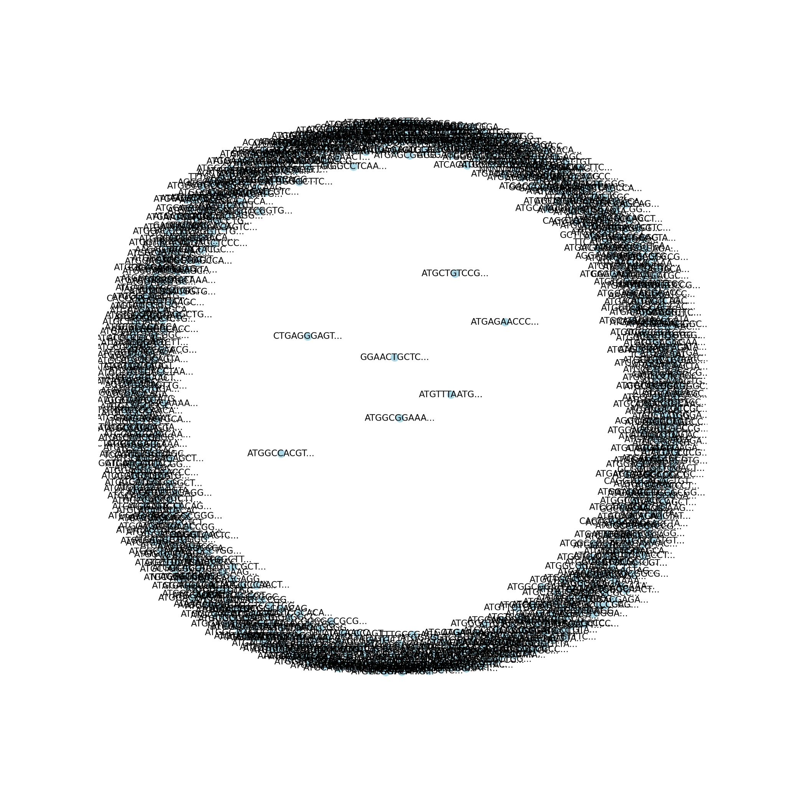
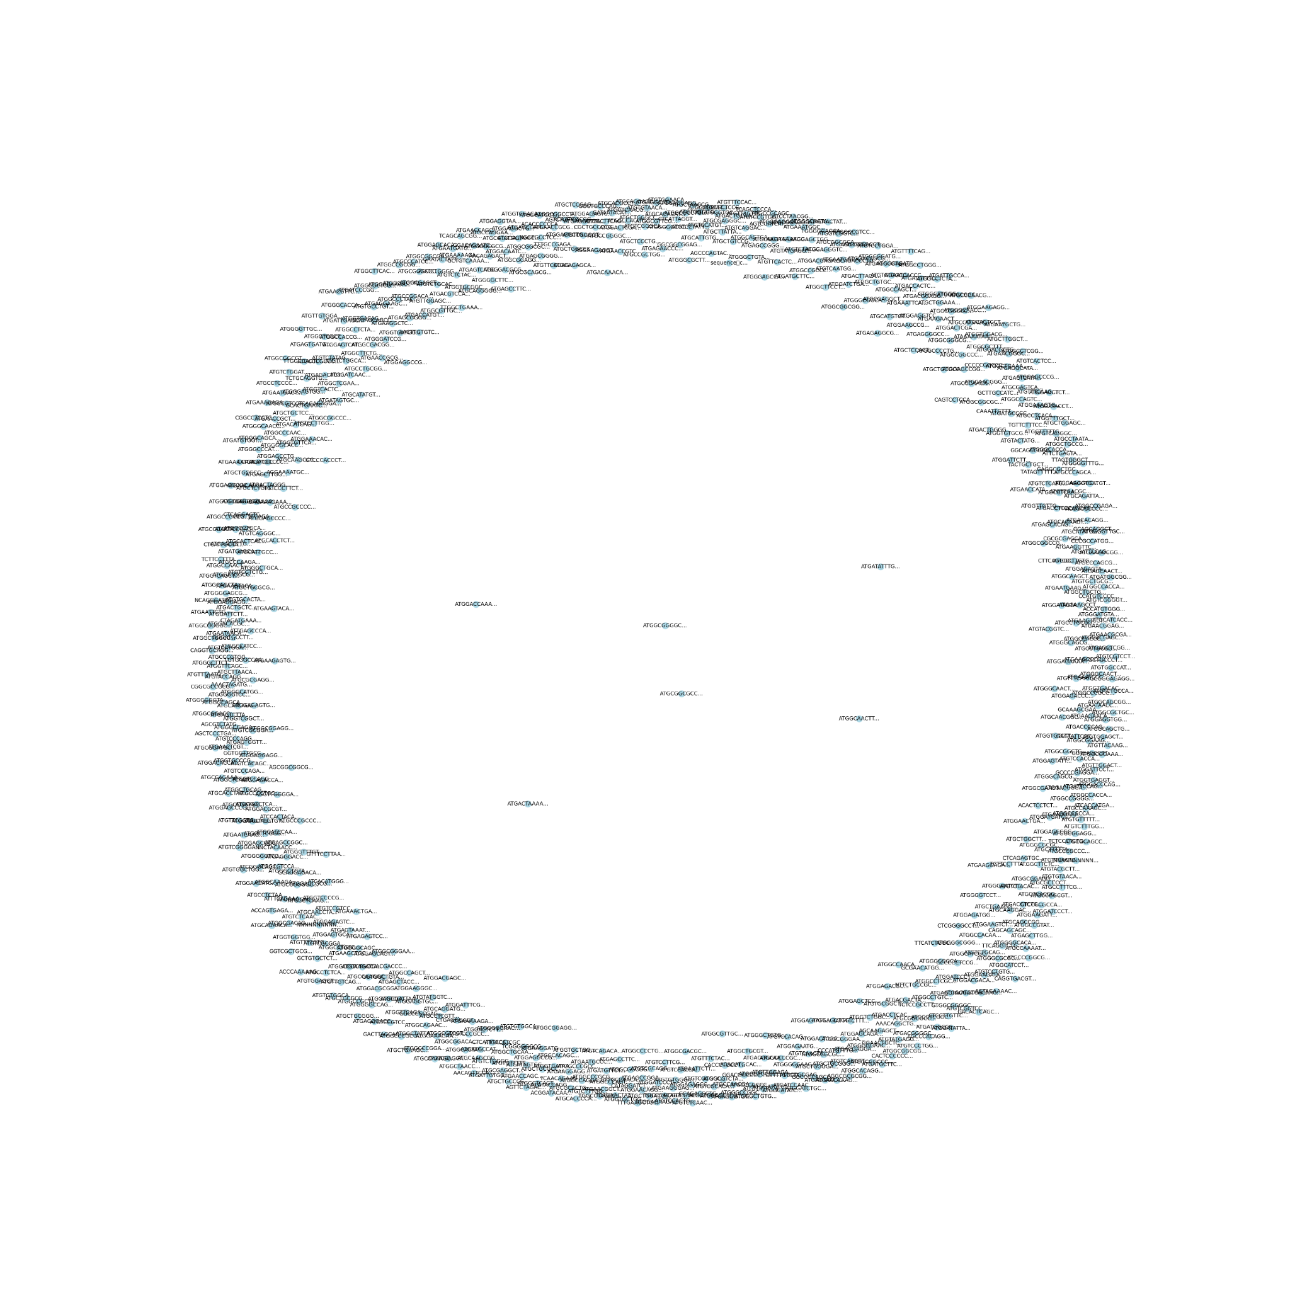
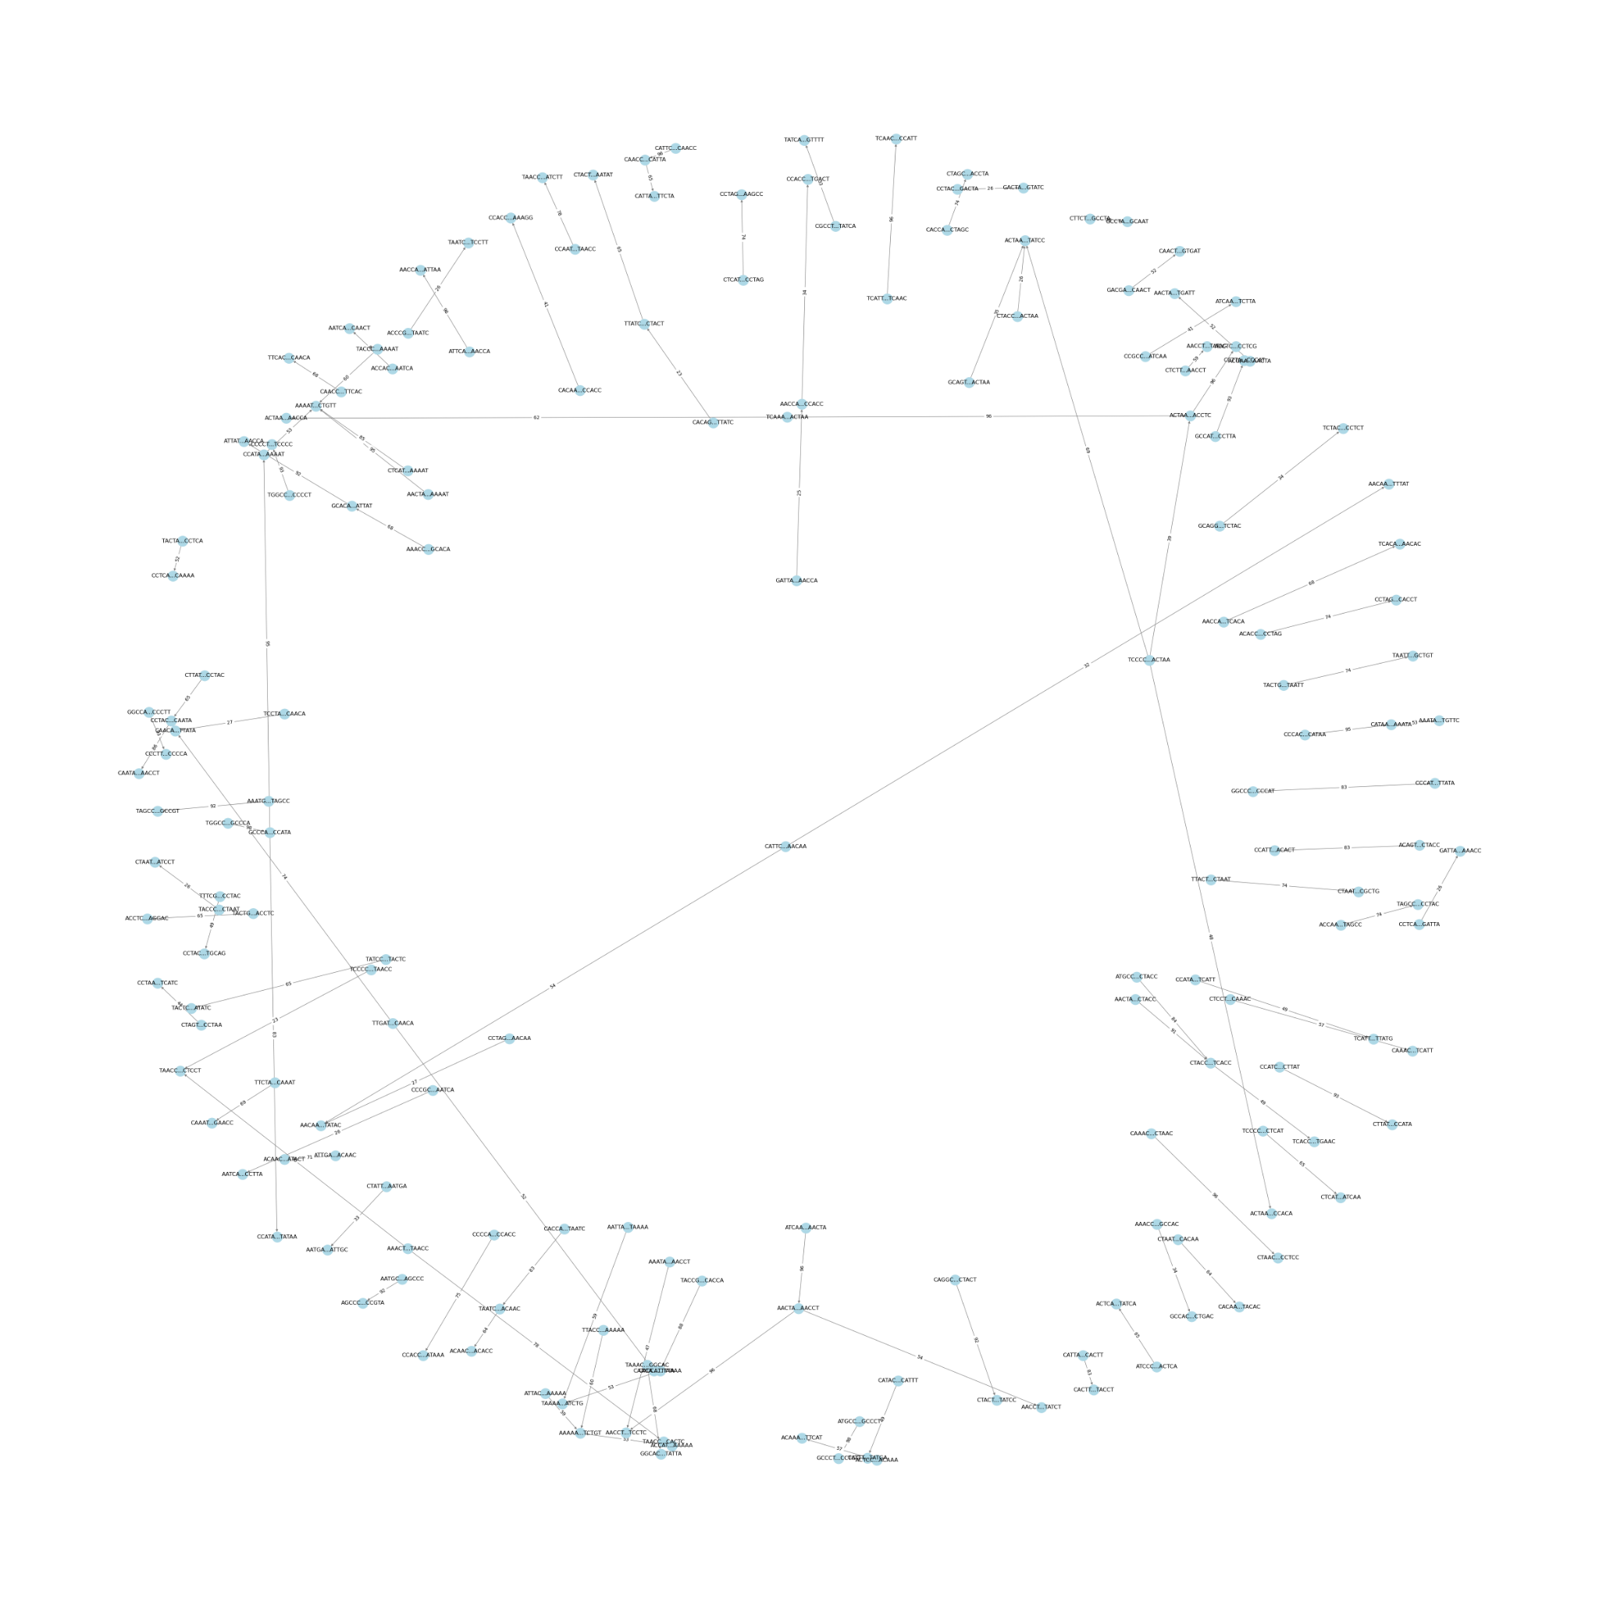
BACK ON TRACK:

Slide 19
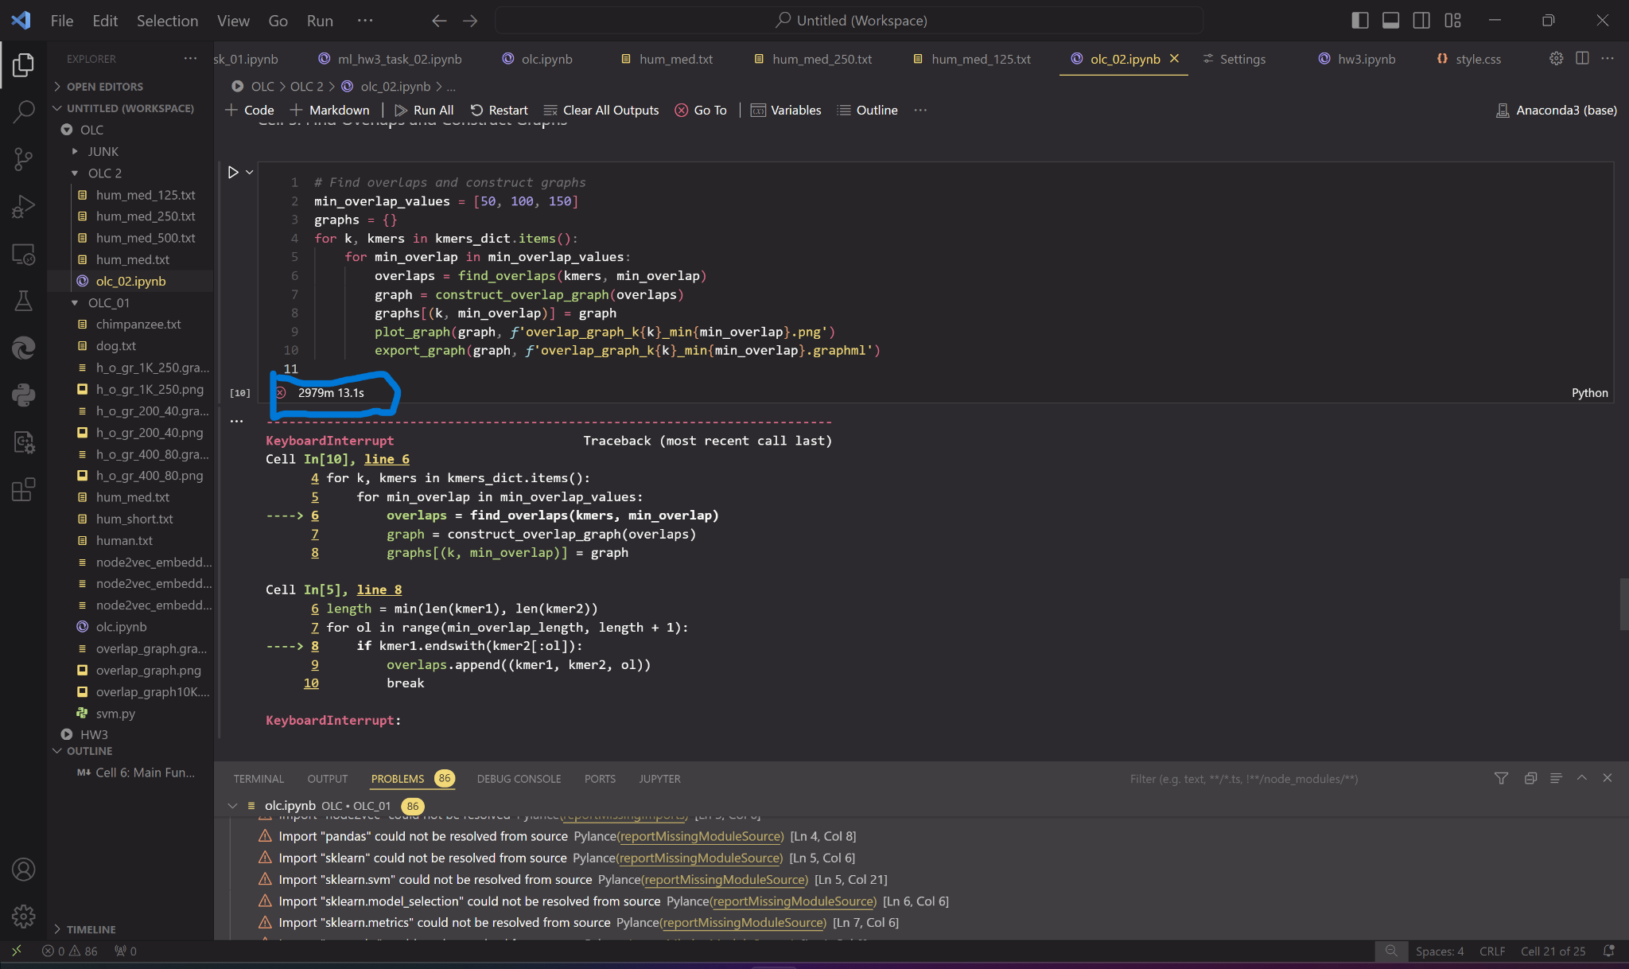
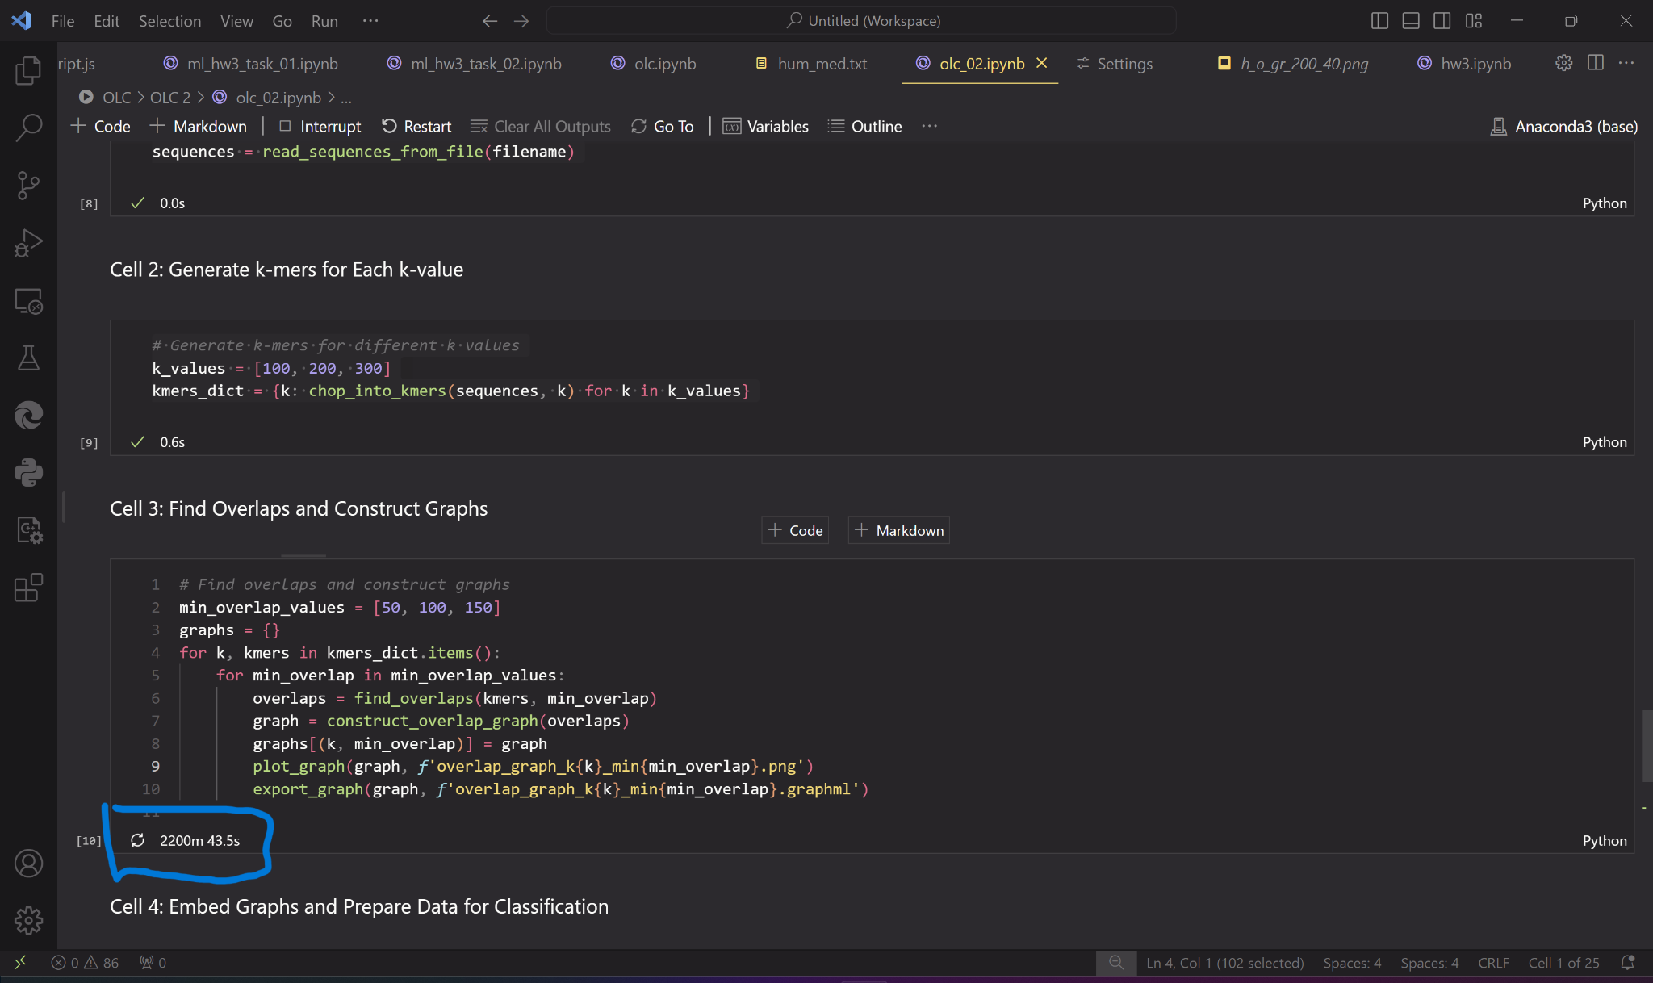
BACK ON TRACK:
CONSTRAINTS TIME + POWER
~ 50 HOURS
36 HOURS

Slide 20
CONCLUSIONS:
What we learned.
What are overlap graphs and how to construct them.
Overlap-Layout-Consensus is a very effective algorithm to assemble a genome when written in C lang.
Genome assembly and Sequence Classification are not the same thing. Obviously…
Minimap2 + Miniasm is another very efficiency approach to assemble a genome when dealing with long reads.
Although it’s probably feasible, but not very sensible to use and overlap graph for a problem of sequence classification. It’s worth considering to use De-Bruijn Graph for such problems.
Python is slow. One may consider using faster languages such as C, to
Implement the algorithms that work with large datasets, such as DNA.

Slide 21
THANK YOU !
Omar Madjitov & Alenka Tang

